Slide 1
State of the Economy
Ajsa Suljic, Regional Labor Economist
Labor Market Information and Research
Washington Employment Security Department

Slide 2
Labor around the state
The state’s labor force in September 2024 was at 3,979,535
From September 2023 through September 2024, the state’s labor force decreased by -57,538
Resident labor force employment rate is at 95.8%
Over 166,476 people are actively looking for work
Current September 2024 unemployment rate at 4.2% NSA
Notes:
TLF decrease over the year is at 1.43 percent
That is over 57,538 people who left the LF compared Sep 2023 while over the month LF decreased by 0.53% or 21,000
Total resident employment was at 95.8% number of employed residents decreased by -62,349 or -1.56% over the year while over the month it increased by 0.20% or 7,685.
Number of unemployed increased by 3.0% or 4,811 OTY while OTM number was down by -28,686 or -14.7%
NSA UI rate for WA State was 4.2% down from Aug rate of 4.9% rate and up from Sep 2023 rate of 4.0%

Slide 3
Employment around the state
The state’s nonfarm employment in September 2024 was at 3,661,500 jobs
From September 2023 through September 2024, the state’s nonfarm employment grew by 44,600 new jobs
Over 95,646 jobs are currently listed by employers on WS-WA
Notes:
Nonfarm employment changes in Washington for September 2024, both over-the-month (OTM) and over-the-year (OTY), along with industry details:
Over-the-Month (OTM) Changes (August 2024 to September 2024)
Total Nonfarm: Decreased by 6,900 jobs (-0.2%).
Total Private: Decreased by 13,400 jobs (-0.4%).
Goods Producing: Decreased by 1,600 jobs (-0.3%).
Mining and Logging: No change.
Construction: Decreased by 1,200 jobs (-0.5%).
Construction of Buildings: Decreased by 800 jobs (-1.2%).
Heavy and Civil Engineering: Decreased by 600 jobs (-2.6%).
Specialty Trade Contractors: Increased by 200 jobs (0.1%).
Manufacturing: Decreased by 400 jobs (-0.1%).
Durable Goods: Increased by 800 jobs (0.4%).
Non-Durable Goods: Decreased by 1,200 jobs (-1.1%).
Over-the-Year (OTY) Changes (September 2023 to September 2024)
Total Nonfarm: Increased by 44,600 jobs (1.2%).
Total Private: Increased by 26,000 jobs (0.9%).
Goods Producing: Increased by 2,200 jobs (0.4%).
Mining and Logging: Decreased by 700 jobs (-12.1%).
Construction: Increased by 5,300 jobs (2.2%).
Construction of Buildings: Increased by 1,800 jobs (2.8%).
Heavy and Civil Engineering: Increased by 400 jobs (1.8%).
Specialty Trade Contractors: Increased by 3,100 jobs (2.1%).
Manufacturing: Decreased by 2,400 jobs (-0.9%).
Durable Goods: Increased by 700 jobs (0.4%).
Non-Durable Goods: Decreased by 3,100 jobs (-2.1%).

Slide 4
Skamania County

Slide 5
Labor Force Skamania County
County labor force in September 2024 was at 5,391
From September 2023 through September 2024, the counties labor force decreased by 86 workers
Resident labor force employment rate is at 95.9%
Over 219 people are actively looking for work
Current unemployment rate was at 4.1%
Notes:
Labor Force
September 2024 (Preliminary): 5,391
September 2023 (Revised): 5,477
OTY Change: Decreased by 86
OTY % Change: -1.6%
Employment
September 2024 (Preliminary): 5,172
September 2023 (Revised): 5,252
OTY Change: Decreased by 80
OTY % Change: -1.5%
Unemployment
September 2024 (Preliminary): 219
September 2023 (Revised): 225
OTY Change: Decreased by 6
OTY % Change: -2.7%
Unemployment Rate
September 2024 (Preliminary): 4.1%
September 2023 (Revised): 4.1%
OTY Change: No change
OTY % Change: 0.0%
Analysis
Labor Force: The labor force saw a slight decline, indicating a small reduction in the number of people either employed or actively seeking employment.
Employment: Employment figures also decreased, reflecting fewer people being employed compared to the previous year.
Unemployment: The number of unemployed individuals decreased slightly, which could suggest some improvement in job placements or a reduction in the number of people actively seeking jobs.
Unemployment Rate: The unemployment rate remained stable at 4.1%, indicating that the proportion of the labor force that is unemployed did not change over the year.

Slide 6
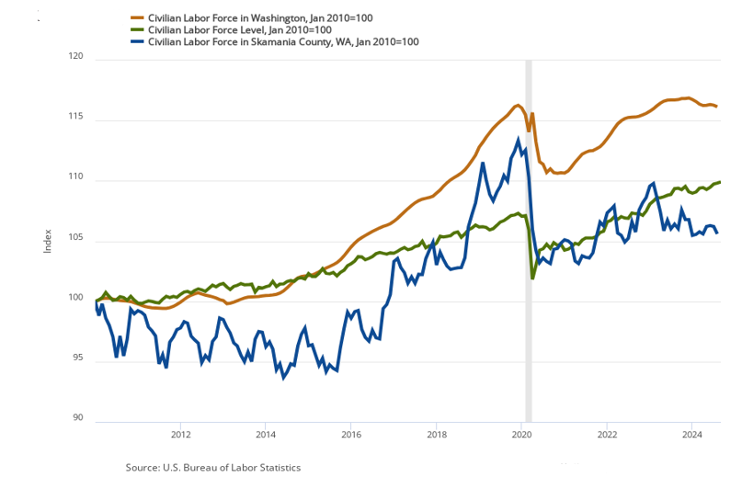
Labor Force Skamania County

Slide 7
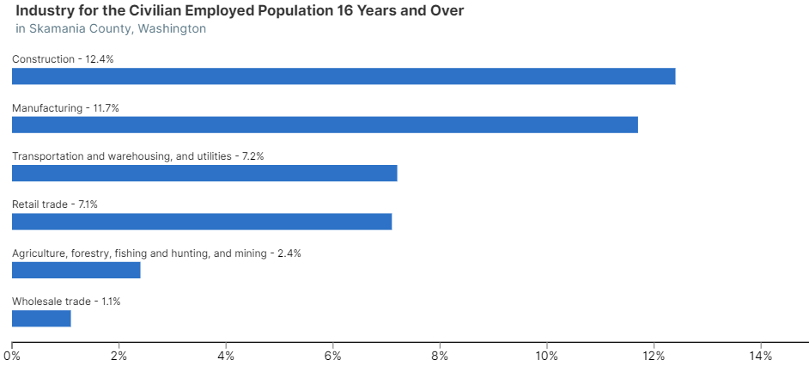
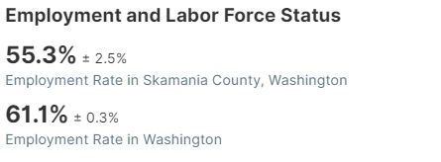
Labor Force Skamania County

Slide 8
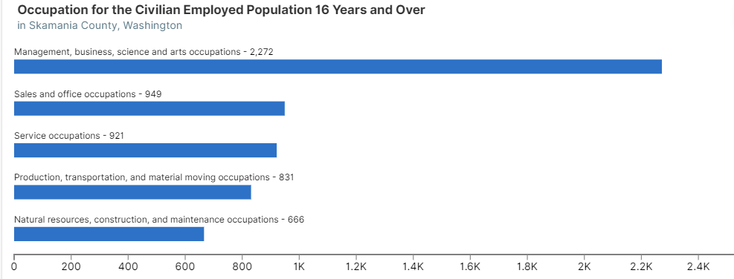
Labor Force Skamania County

Slide 9
Nonfarm Employment
Skamania County
Skamania County nonfarm employment in September 2024 was at 2,350 jobs
From Sep.’23 through Sep’24, nonfarm employment increased by 40 jobs
Industries of growth OTY include manufacturing (2.9%); construction (22.2%);trade, transportation and utilities (3.7%), government (3.1%)
Industries decreasing OTY include leisure and hospitality (-1.6%), all other industries remained unchanged
Around 396 jobs were listed through WorkSourceWA.com for the local area
Notes:
Key Changes in Skamania County Employment
Over the Month (August 2024 to September 2024)
Total Nonfarm: Increased by 40 jobs (1.7%)
Private Sector: Increased by 40 jobs (2.4%)
Service Providing: Increased by 30 jobs (1.6%)
Over the Year (September 2023 to September 2024)
Total Nonfarm: Increased by 30 jobs (1.3%)
Government: Increased by 20 jobs (3.1%)
K-12 Education: Increased by 20 jobs (10.5%)
Notable Industries
Manufacturing: Increased by 10 jobs over the month (2.9%) and remained stable over the year.
Trade, Transportation, and Utilities: Increased by 10 jobs over both the month (3.7%) and the year (3.7%).
Leisure and Hospitality: Increased by 10 jobs over the month (1.7%) but decreased by 10 jobs over the year (-1.6%).

Slide 10
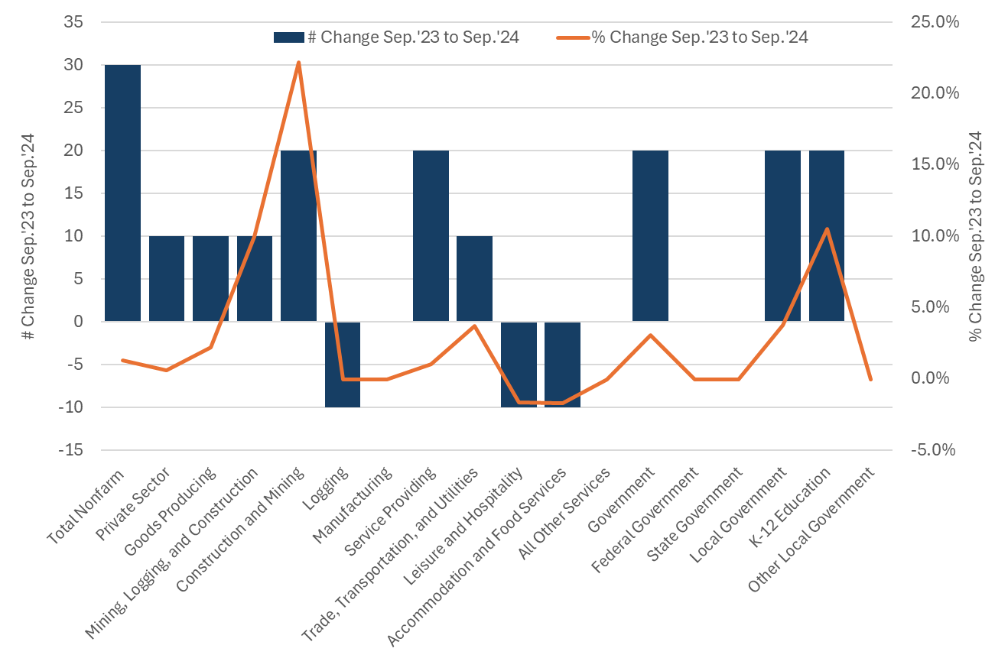
Nonfarm Employment by Industry Change
Skamania County

Slide 11
Total Covered Employment

Slide 12
Total Covered Employment
Skamania County, WA, 2023

Slide 13
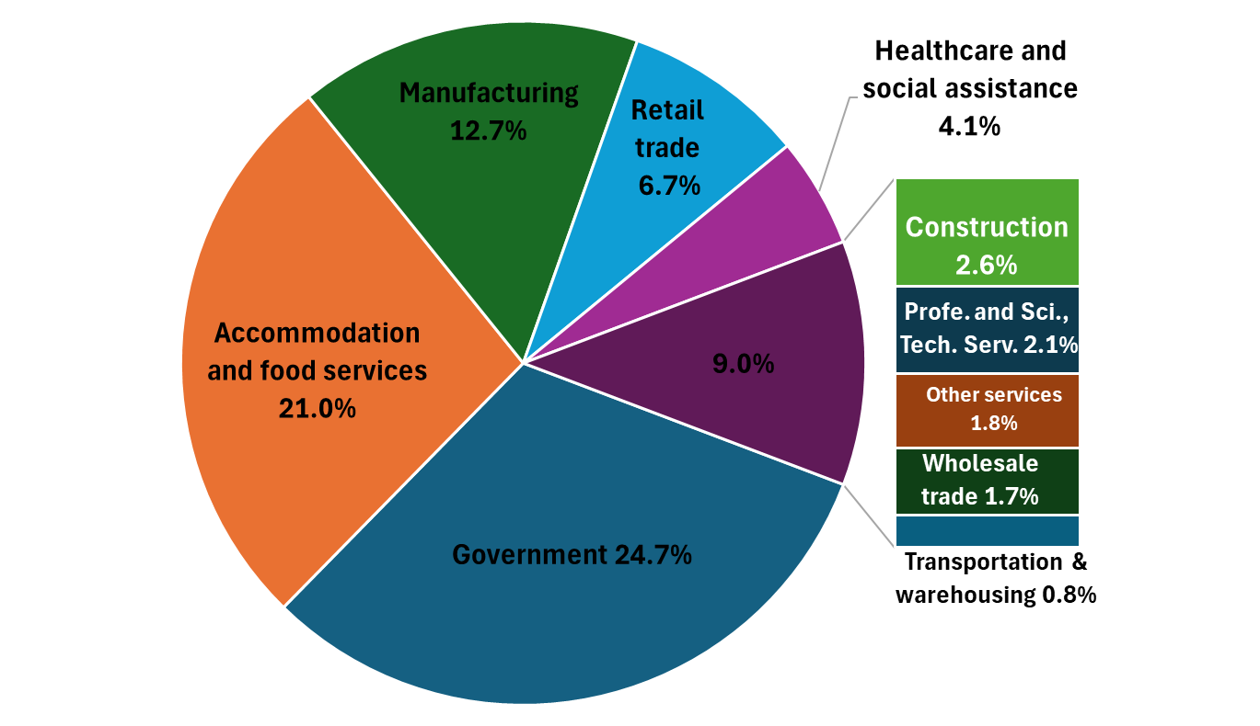
Percentage Share of Total Employment
Skamania County, WA 2023

Slide 14
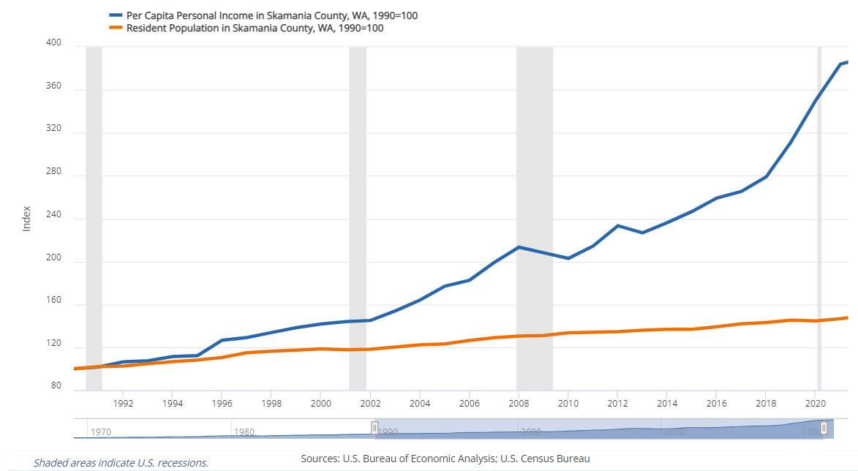
Resident Population and Personal Income
Skamania County, WA
Notes:
Population Trends in Skamania County, WA
As of 2024, Skamania County has an estimated population of 12,825, reflecting a growth rate of 1.46% over the past year. The county’s population has been steadily increasing, with a diverse demographic composition. The median age is 46.3 years, and the population is almost evenly split between males and females.
Personal Income Trends in Skamania County, WA
In 2022, the median household income in Skamania County was $87,986. The per capita personal income was $62,472, showing a modest increase of 1.5% from the previous year. This places Skamania County 11th out of 39 counties in Washington for per capita income
Between 2020 and 2022, the per capita personal income in Skamania County, Washington, saw a significant increase. In 2020, the per capita personal income was approximately $54,0001. By 2022, it had risen to about $62,472, marking an increase of around 15.7%.

Slide 15
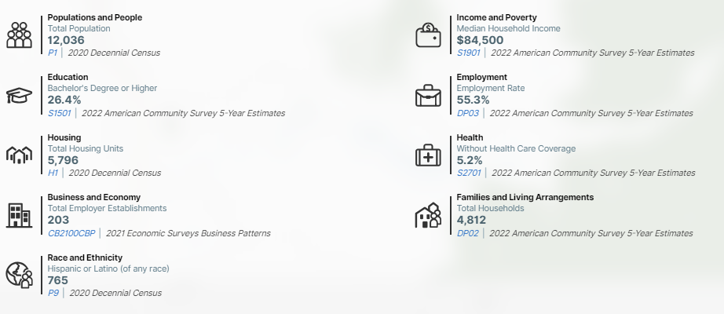
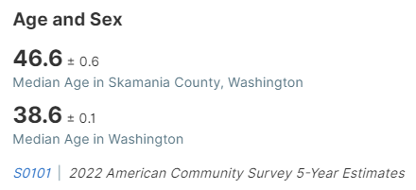
Resident Population and Personal Income
Skamania County, WA
Notes:
From 2020 to 2022, the median household income in Skamania County, Washington, saw a notable increase. In 2020, the median household income was approximately $75,565. By 2022, it had risen to around $84,500. This represents an increase of about 11.8%.
Between 2020 and 2022, Skamania County, Washington, experienced a population increase. In 2020, the population was approximately 12,036. By 2022, it had grown to about 12,455, representing an increase of around 3.5%.

Slide 16
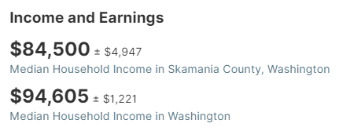
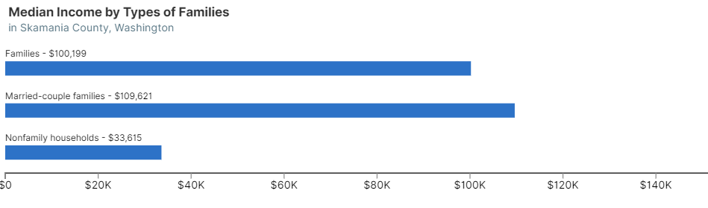
Resident Population and Personal Income
Skamania County, WA

Slide 17
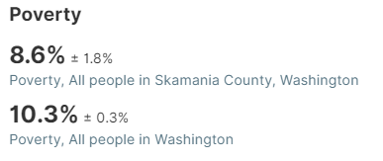
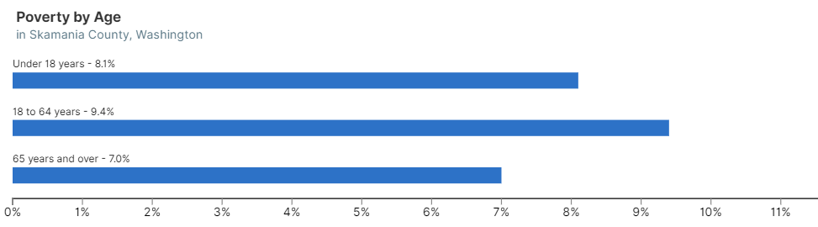
Resident Population and Personal Income
Skamania County, WA
Notes:
Between 2020 and 2022, the poverty rate in Skamania County, Washington, saw a decrease. In 2020, the poverty rate was approximately 12.5%. By 2022, it had decreased to about 11.8%, marking a reduction of around 0.7 percentage points

Slide 18
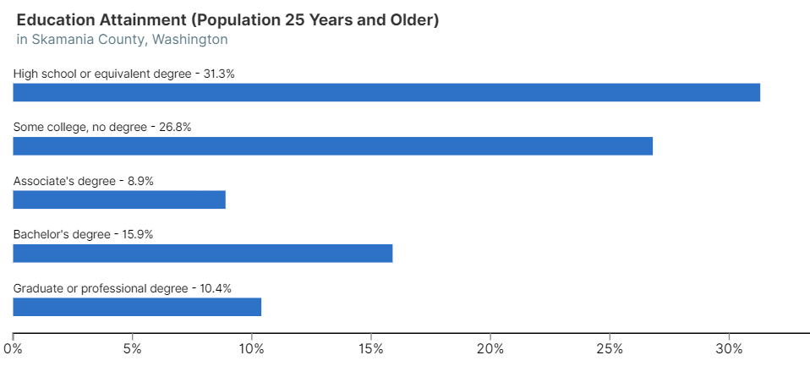
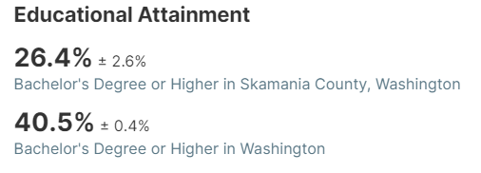
Resident Population and Personal Income
Skamania County, WA

Slide 19
Klickitat County

Slide 20
Labor Force Klickitat County
County labor force in September 2024 was at 10,077
From September 2023 through September 2024, the counties labor force increased by 338 workers
Resident labor force employment rate is at 96.2%
Over 381 people are actively looking for work
Current unemployment rate was at 3.8%
Notes:
Over the Year Changes for Klickitat County, WA
Labor Force
September 2024: 10,077
September 2023: 9,739
Change: Increased by 338 (3.5%)
Employment
September 2024: 9,696
September 2023: 9,337
Change: Increased by 359 (3.8%)
Unemployment
September 2024: 381
September 2023: 402
Change: Decreased by 21 (-5.2%)
Unemployment Rate
September 2024: 3.8%
September 2023: 4.1%
Change: Decreased by 0.3%
Summary
Klickitat County saw a notable increase in both the labor force and employment over the past year, while unemployment and the unemployment rate decreased, indicating a strengthening job market.

Slide 21
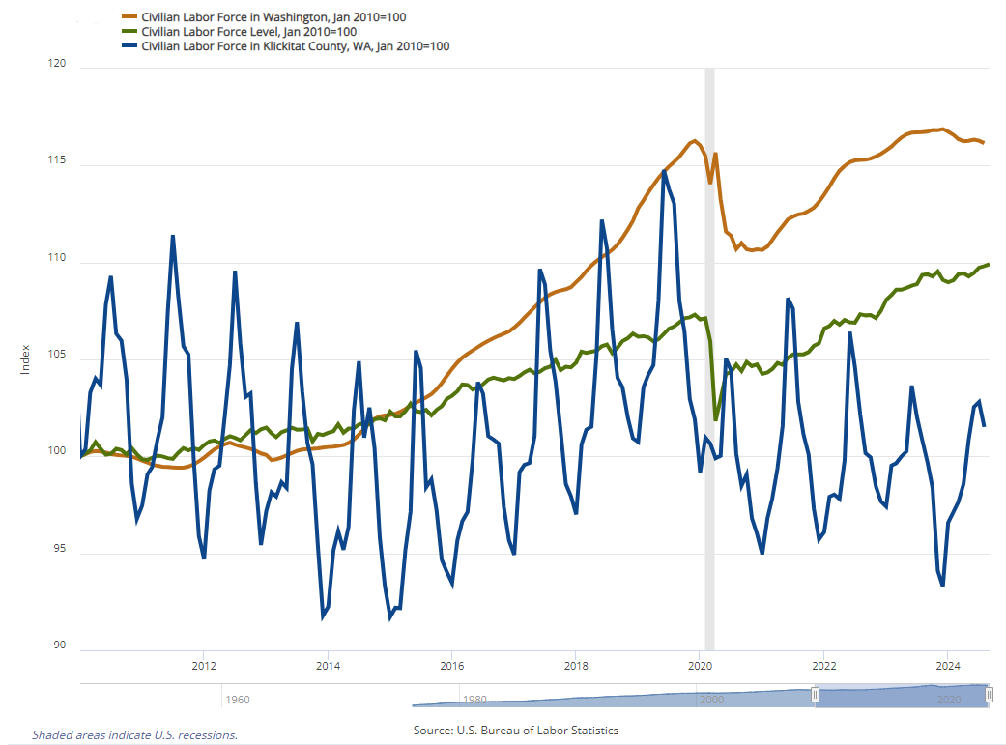
Labor Force Klickitat County

Slide 22
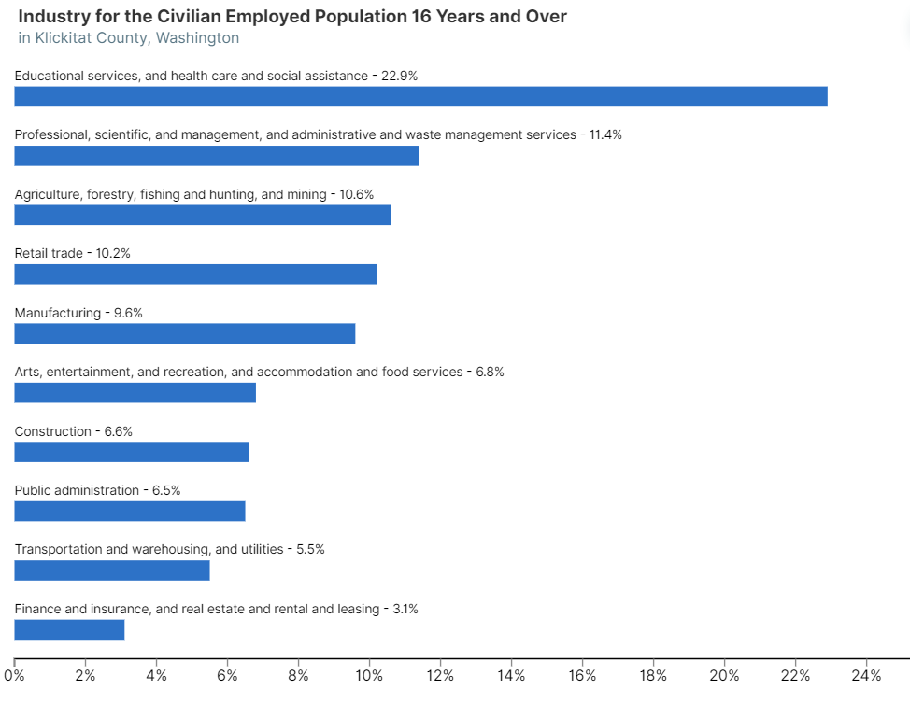
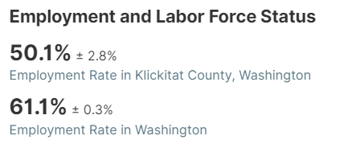
Labor Force Klickitat County

Slide 23
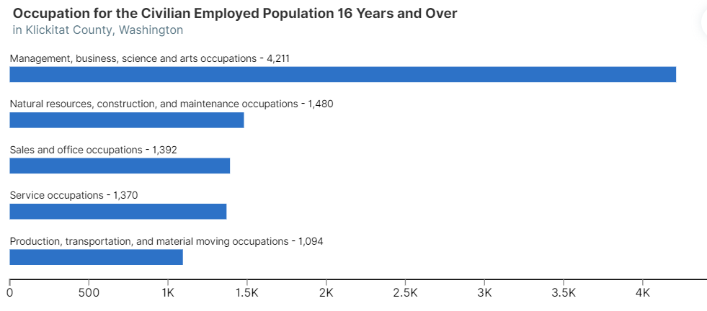
Labor Force Klickitat County

Slide 24
Nonfarm Employment
Klickitat County
Nonfarm employment in September 2024 was at jobs 6,730
From Sep.’23 through Sep’24, nonfarm employment increased by 120 jobs
Industries of growth OTY include wholesale trade (14.3%); manufacturing (6.6%); government (5.0%) all other services (3.4%); professional and business services (1.4%)
Industries decreasing OTY include education and healthcare (-8.5%); trade, transportation and utilities (-8.3%), leisure and hospitality (-5.9%), retail trade (-2.0%); construction (-2.9%) all other industries remained unchanged
Around 615 jobs were listed through WorkSourceWA.com for the local area
Notes:
Over-the-Year Changes in Nonfarm Employment for Klickitat County, WA
Total Nonfarm Employment
September 2024: 6,730
September 2023: 6,610
Change: Increased by 120 jobs (1.8%)
Private Sector
September 2024: 4,830
September 2023: 4,800
Change: Increased by 30 jobs (0.6%)
Goods Producing
September 2024: 1,700
September 2023: 1,620
Change: Increased by 80 jobs (4.9%)
Service Providing
September 2024: 5,030
September 2023: 4,990
Change: Increased by 40 jobs (0.8%)
Government
September 2024: 1,900
September 2023: 1,810
Change: Increased by 90 jobs (5.0%)
Analysis
The overall nonfarm employment in Klickitat County saw a modest increase over the year, with notable growth in both the private and public sectors. The goods-producing sector, which includes industries like manufacturing and construction, showed a healthy increase. The service-providing sector also experienced growth, particularly in trade, transportation, and utilities. Government employment saw a significant rise, especially in local government and K-12 education, indicating a strengthening job market in these areas.

Slide 25
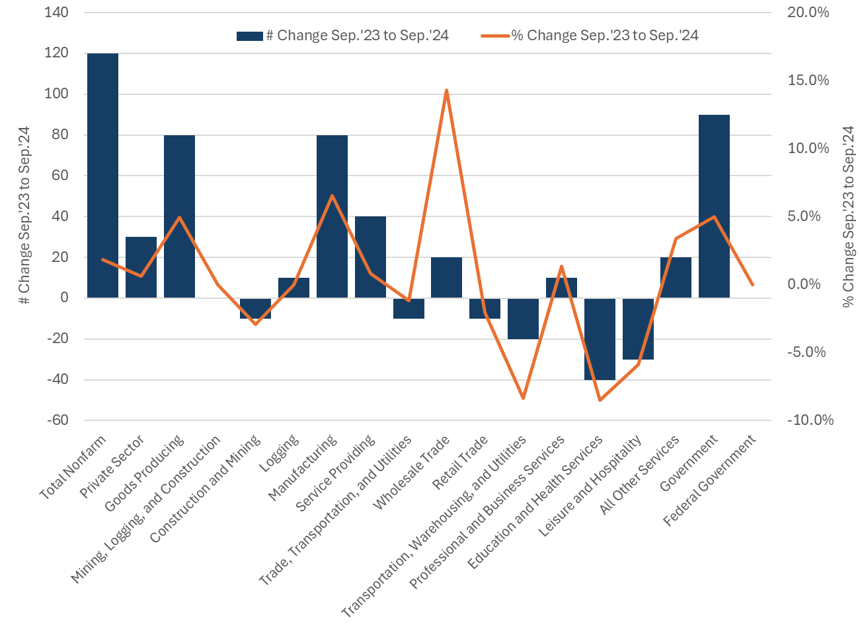
Nonfarm Employment by Industry Change Klickitat County

Slide 26
Total Covered Employment

Slide 27
Total Covered Employment
Klickitat County, WA 2023

Slide 28
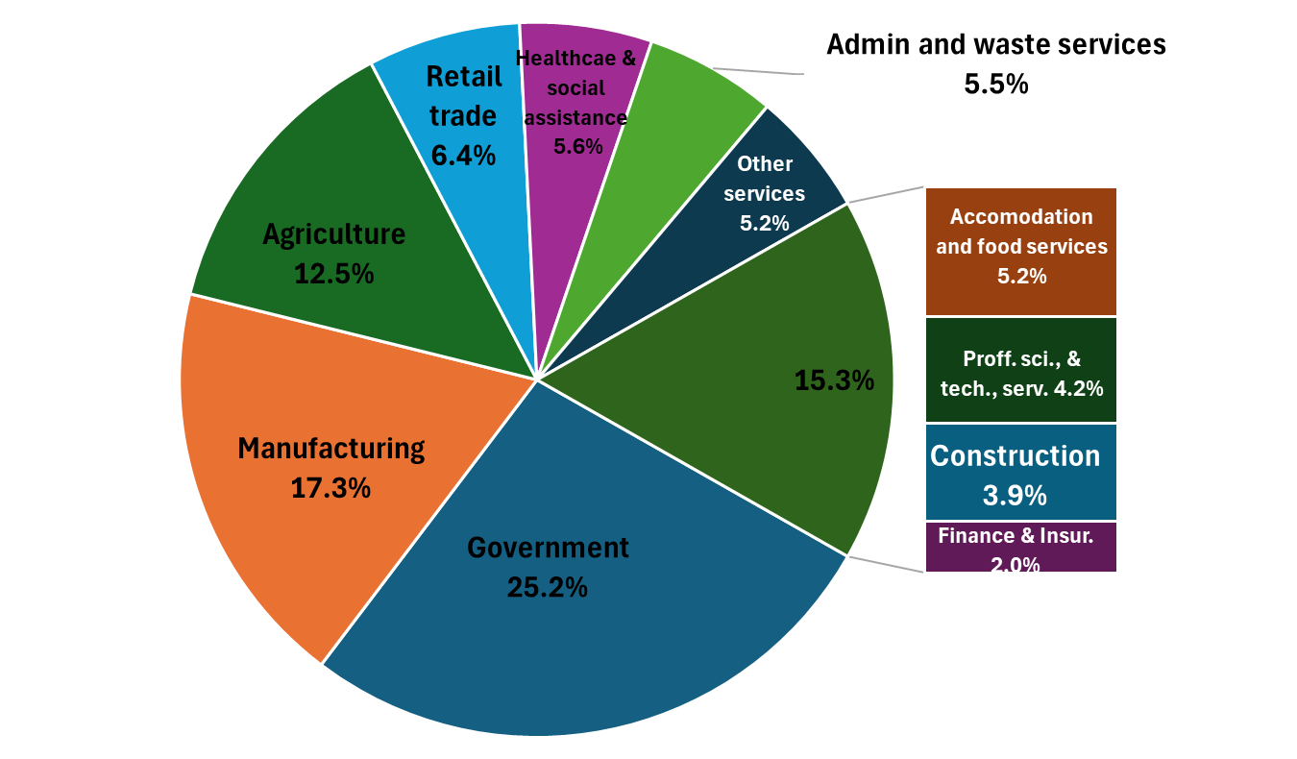
Percentage Share of Total Employment
Klickitat County, WA 2023

Slide 29
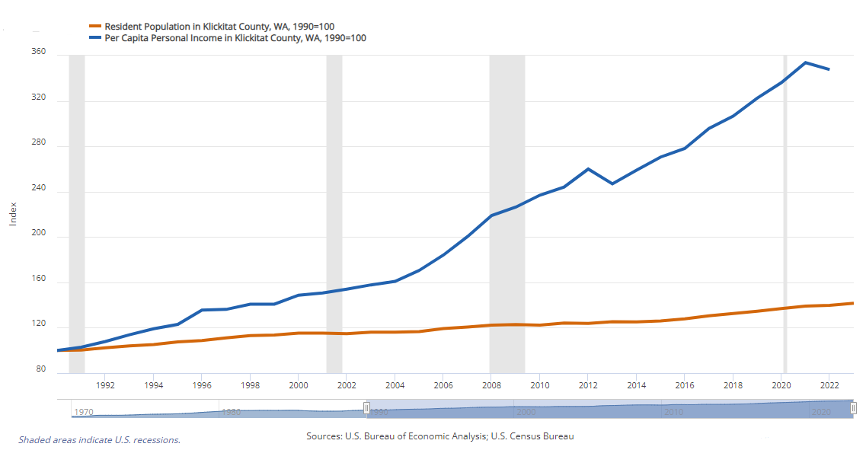
Resident Population and Personal Income
Klickitat County, WA
Notes:
Population Trends
As of July 1, 2023, the estimated population of Klickitat County was 23,589, reflecting a growth of 3.8% since April 2020. The population has steadily increased over the past decade, from 20,318 in 2010 to 22,735 in 2020.
Personal Income Trends
In 2022, the median household income in Klickitat County was $66,581, which marked an increase of 11.7% from the previous year. The average annual household income was $81,819, with significant variations across different age groups. For instance, residents aged 25 to 44 earned an average of $73,326, while those aged 45 to 64 had a median income of $83,750.
Additionally, the per capita personal income in 2022 was $53,305, showing a consistent upward trend over the years. Between 2020 and 2022, the per capita personal income in Klickitat County, Washington, saw a notable increase. In 2020, the per capita personal income was approximately $50,000. By 2022, it had risen to about $53,305, marking an increase of around 6.6%.

Slide 30
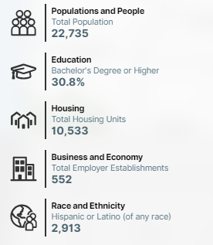
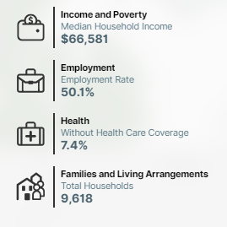
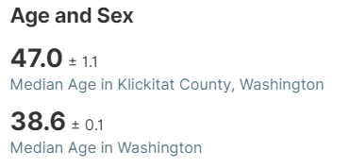
Resident Population and Personal Income
Klickitat County, WA
Notes:
Between 2020 and 2022, the median household income in Klickitat County, Washington, experienced a significant increase. In 2020, the median household income was approximately $64,212. By 2022, it had risen to about $66,581, marking an increase of around 3.7%.
Between 2020 and 2022, Klickitat County, Washington, experienced a population increase. In 2020, the population was approximately 22,735. By 2022, it had grown to about 23,271, representing an increase of around 2.4%

Slide 31
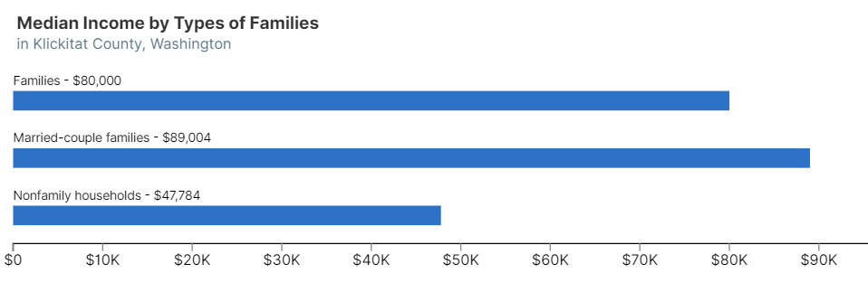
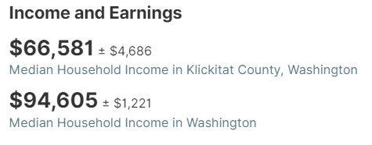
Resident Population and Personal Income
Klickitat County, WA

Slide 32
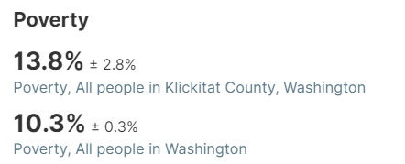
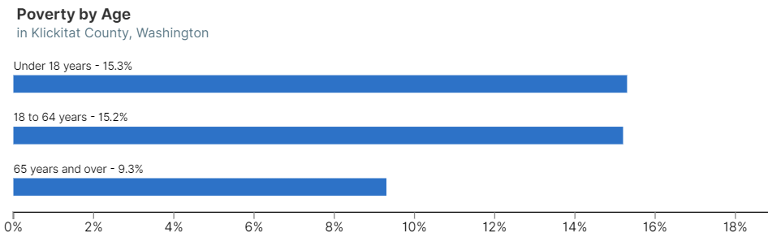
Resident Population and Personal Income
Klickitat County, WA
Notes:
Between 2020 and 2022, the poverty rate in Klickitat County, Washington, saw a decrease. In 2020, the poverty rate was approximately 14.7%. By 2022, it had decreased to about 13.8%, marking a reduction of around 0.9 percentage points.

Slide 33
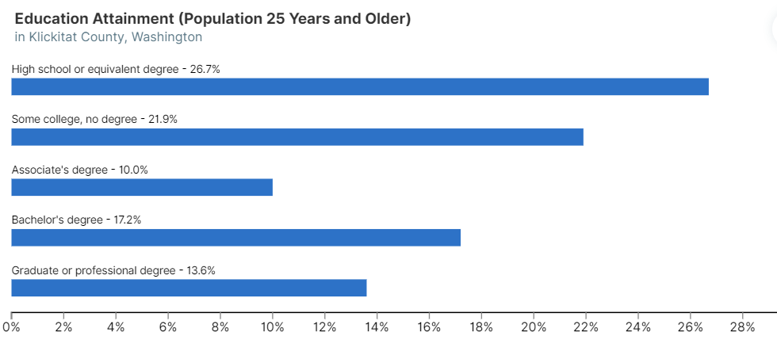
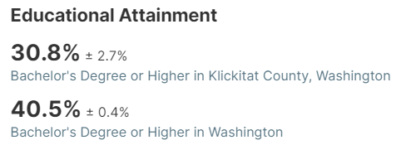
Resident Population and Personal Income
Klickitat County, WA

Slide 34
Thank you!
Any questions?
You can find me at
509-734-5928
Ajsa. Suljic@esd.wa.gov
ESD.WA.GOV/labormarketinfo
Notes:
Employment and Economic Outlook for Skamania County, WA in 2024
Employment Trends
Skamania County is expected to see slow but steady employment growth over the next few years. The tourism sector, which was significantly impacted by the COVID-19 pandemic, is recovering and contributing to job creation. Additionally, manufacturing employment has been increasing steadily and is projected to continue this trend.
Economic Outlook
The economic outlook for Skamania County in 2024 is cautiously optimistic. Key factors include:
Tourism: As tourism fully recovers, it is expected to drive economic growth. The county’s natural attractions, such as the Columbia River Gorge, play a significant role in attracting visitors.
Manufacturing: The manufacturing sector has shown consistent growth over the past eight years and is anticipated to remain a vital part of the local economy.
Labor Market: The labor force participation rate is improving, and the unemployment rate is gradually decreasing.
Overall, Skamania County’s economy is diversifying, with both tourism and manufacturing sectors contributing to its resilience and growth.
Employment and Economic Outlook for Klickitat County, WA in 2024
Employment Trends
Klickitat County has seen a steady increase in employment over the past few years. As of 2024, the county’s labor market is showing positive signs of growth, particularly in the manufacturing and renewable energy sectors. The unemployment rate in Klickitat County was 3.8% as of September 2024, which is a slight improvement from previous years.
Economic Outlook
The economic outlook for Klickitat County in 2024 is cautiously optimistic. The county’s economy is bolstered by its strong agricultural base, growing renewable energy projects, and a burgeoning tourism industry. The local government has been investing in infrastructure improvements and workforce development programs to support economic growth.
Key sectors expected to drive economic growth in Klickitat County include:
Renewable Energy: Continued investments in wind and solar energy projects.
Manufacturing: Expansion of local manufacturing facilities.
Tourism: Increased tourism activities, particularly around the Columbia River Gorge.

Slide 35
What is Labor Market Information (LMI)?
Data that describe and predict the relationship between labor supply and demand
LMI provides data on a variety of subjects:
  Population and labor force trends
  Industry and occupational employment trends and projections
  Wage and benefit information
  Career information relating to skills and education
Data are often available at different geographic levels
  e.g., State, county, metro area, workforce development region, etc.

Slide 36
Credits
Special thanks to all the people who made and released these awesome resources:
Presentation and analysis by Ajsa Suljic, Regional Labor Economist
Data by LMEA-DATA team, ESD, BLS, OFM and US Census

