Slide 1


Slide 2
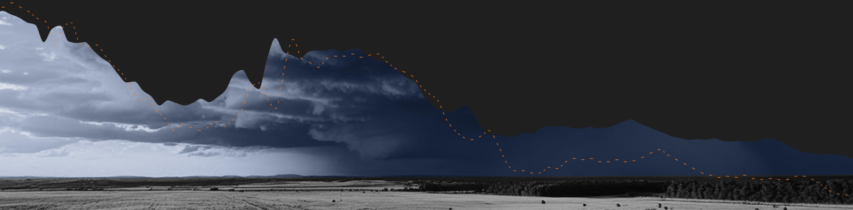
AGENDA
Conditions Forming (past)
The Outer Bands (present)
Where Yakima Stands
Where do we go from here?

Slide 3


About Lightcast
Lightcast is the world’s leading authority on in-demand skills, labor market trends, and talent intelligence.
Lightcast insight and expertise, powered by our best-in-class data on jobs and skills, is used by companies across the globe to better understand their own workforce and find new talent, by education institutions helping prepare their students for the job market, and by community leaders to develop new solutions for growth in their regions.

Slide 4

WORKFORCE PAST
Conditions Forming: The Baby Boomers’ Labor Market

Slide 5
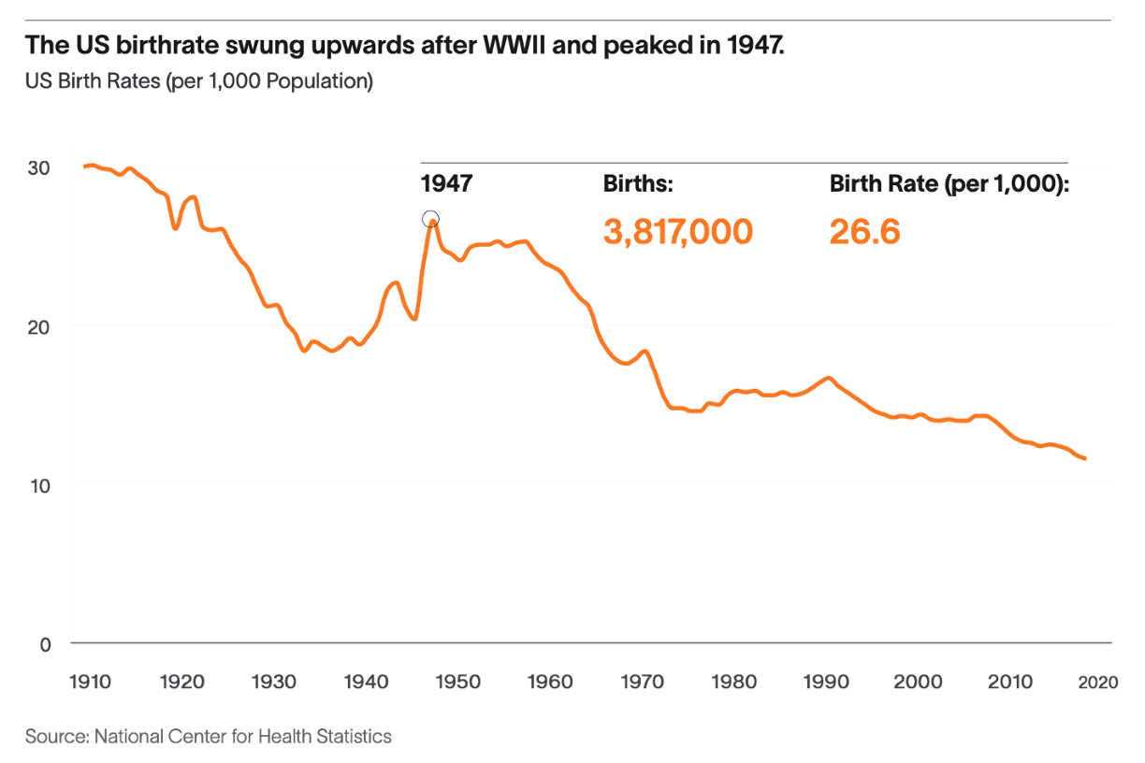
The 1970-90s Workforce Grew Rapidly For Two Main Reasons:
Birth rate was extremely high
Women entered the workforce in droves
THE RISING STORM

Slide 6
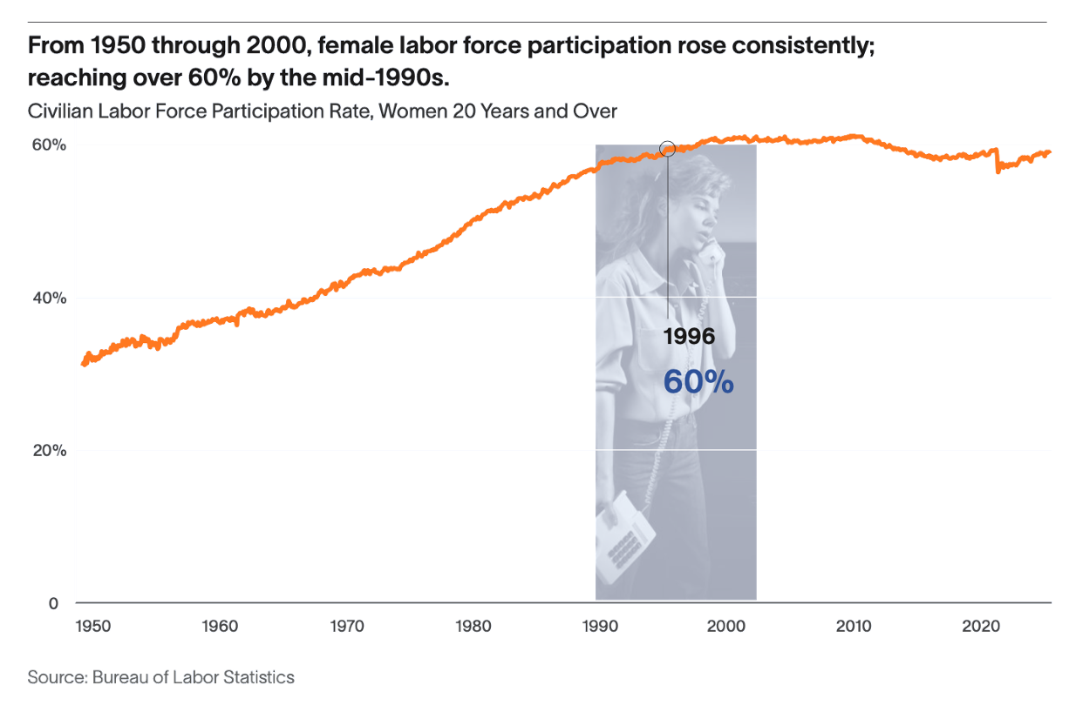
The Workforce Grew Rapidly For Two Main Reasons:
Birth rate was extremely high
Women entered the workforce in droves
THE RISING STORM

Slide 7
Higher Birth Rates And Women Entering Doubled Our Workforce Growth
College Enrollment jumped 100% from 1965 to 1975 and continued to soar for women
21.7M
42.5M
27M
1950-1970
1970-1990
1990-2010
Workforce increase by 20 year period
Source: Statista 2021
THE RISING STORM

Slide 8

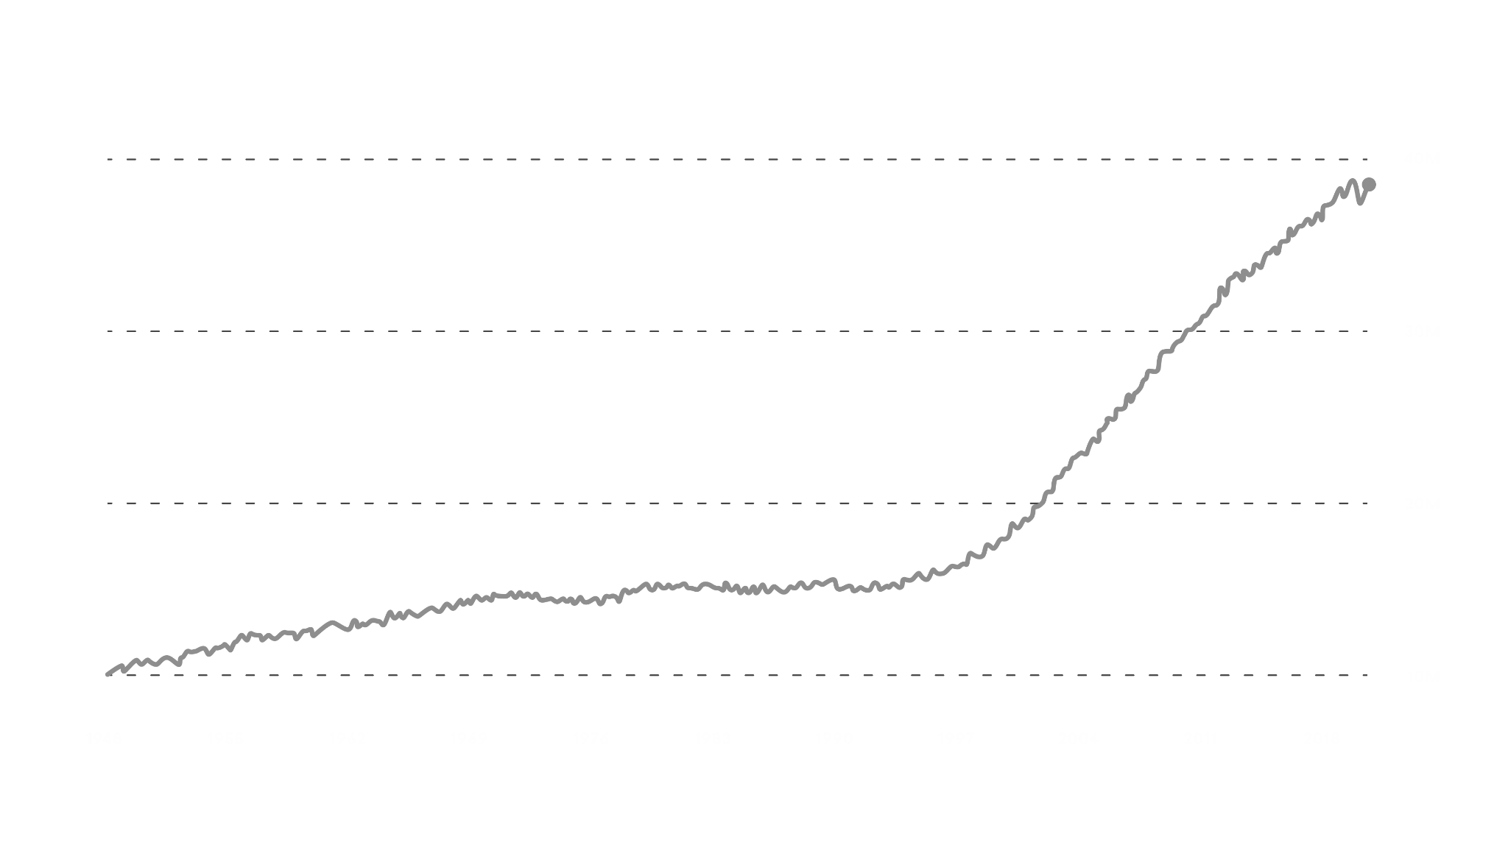
The Silver Tsunami
The US Workforce soared as the Baby Boomer Generation began.
Baby Boomers born:
1946-1964
[Current Ages: 60-78]
US population, age 55+
40M
30M
20M
10M
1948
1955
1962
1969
1976
1983
1990
1997
2004
2011
2018

Slide 9
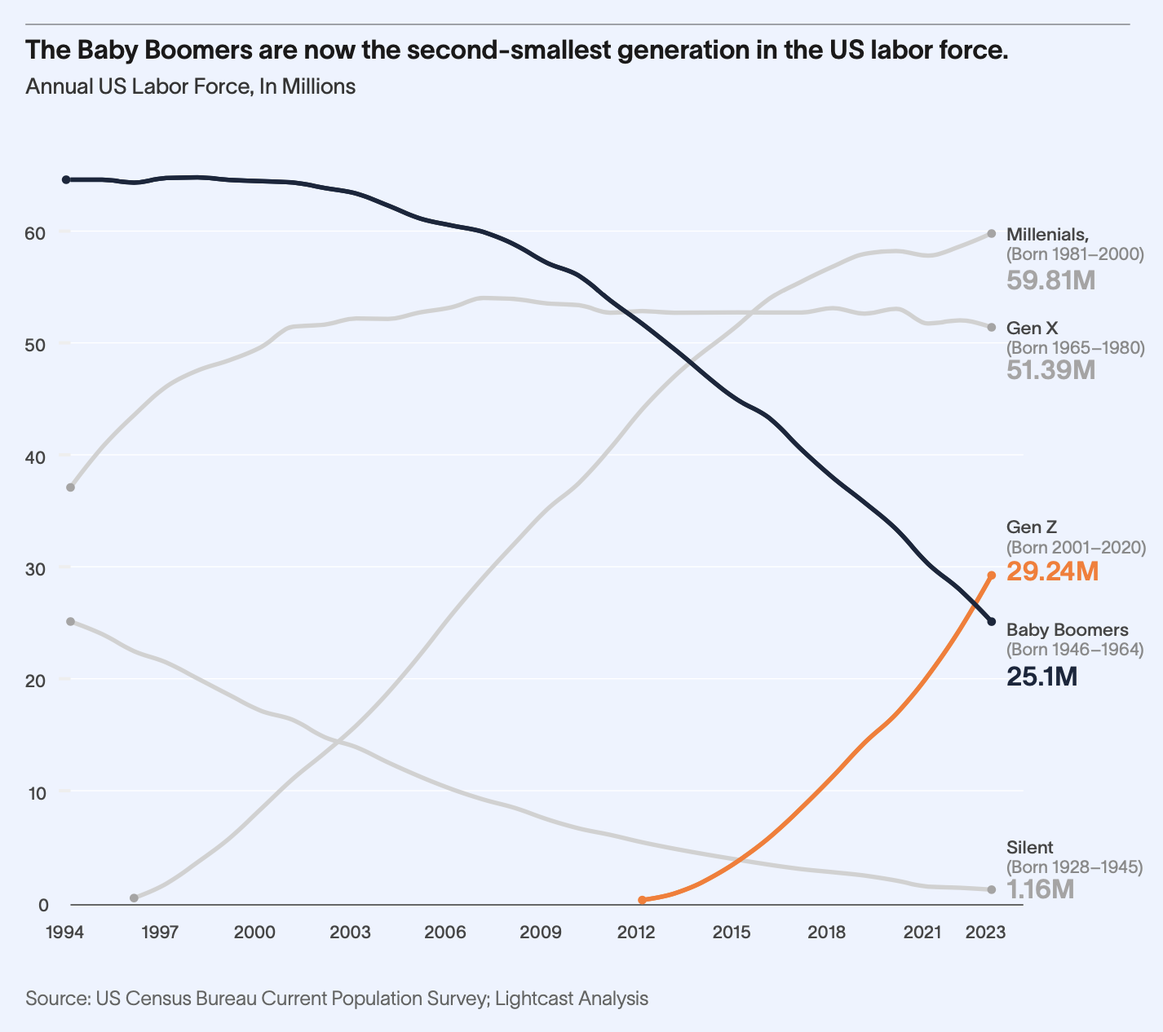
The Silver Tsunami Has Hit Shore
With Boomers heading out of the labor force, they are no longer working, but growing into a huge dependent population.
THE RISING STORM

Slide 10

WORKFORCE FUTURE
Landfall, est. 2028-2034
WORKFORCE PRESENT
The Outer Bands: Today’s Labor Market

Slide 11
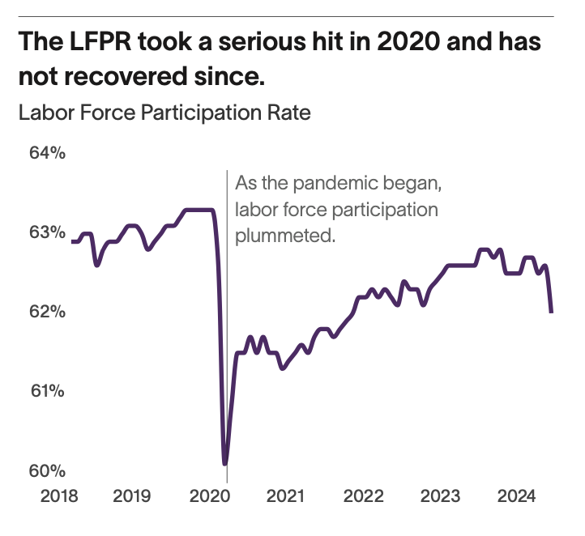
The First
Outer Band
The pandemic pushed an accelerator pedal down on trends that were already coming. People have left the labor force faster than we thought.
THE RISING STORM

Slide 12

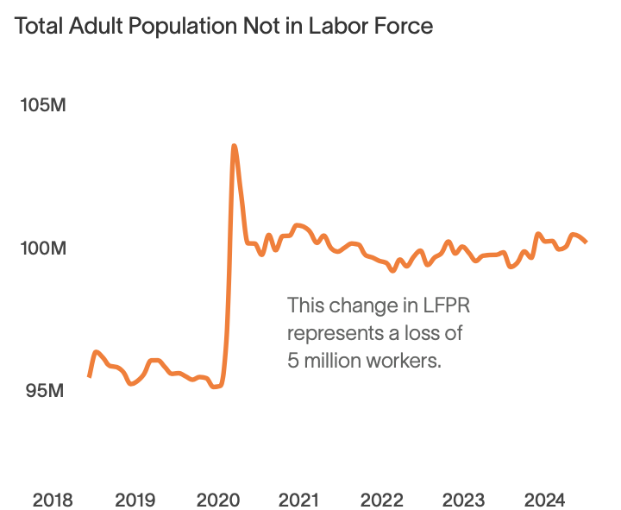
We lost 5 Million People Overnight

Slide 13
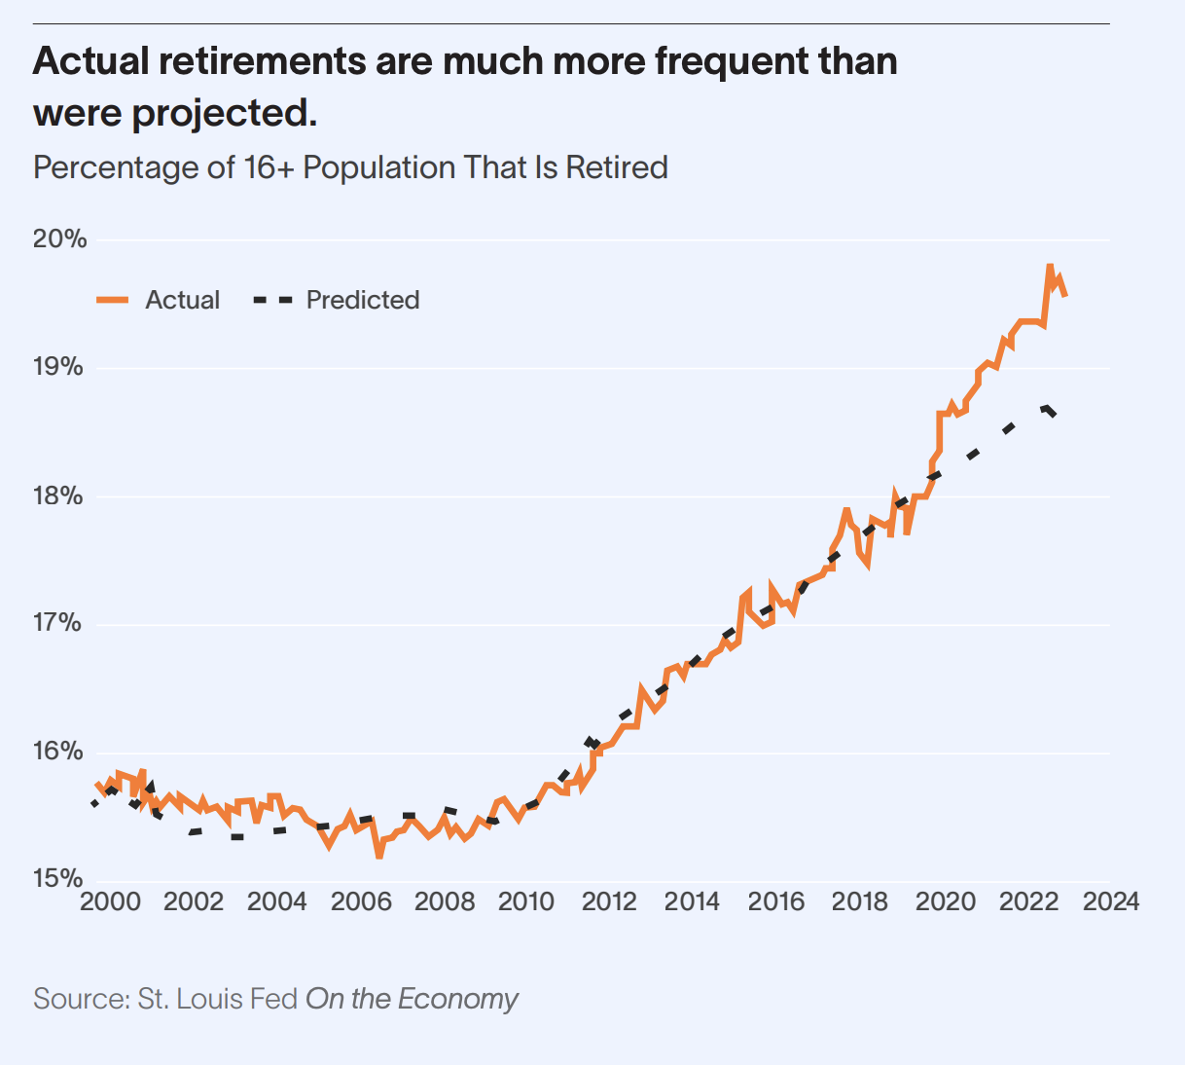
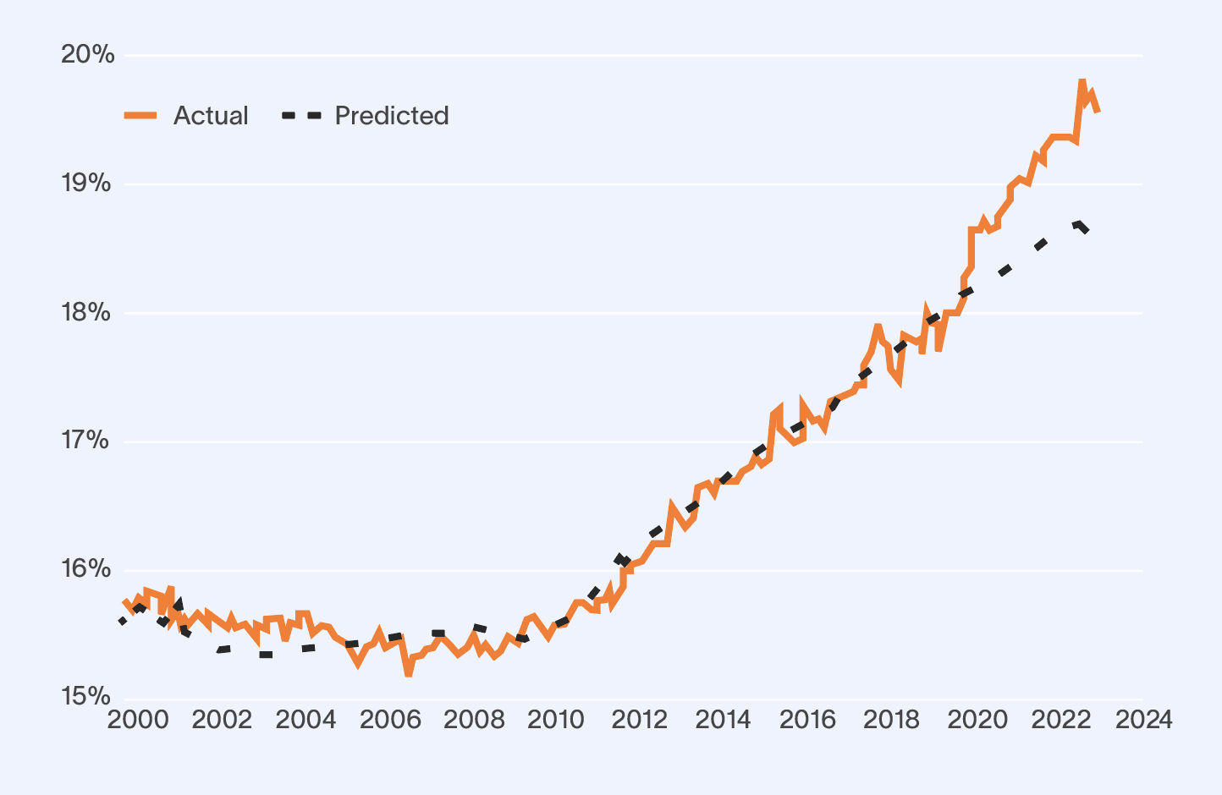
Boomers Are
Exiting The Labor Force En Masse.
Out of the 5 million people who have left the
labor force since 2020,
80% are over the age of 55.
THE RISING STORM

Slide 14
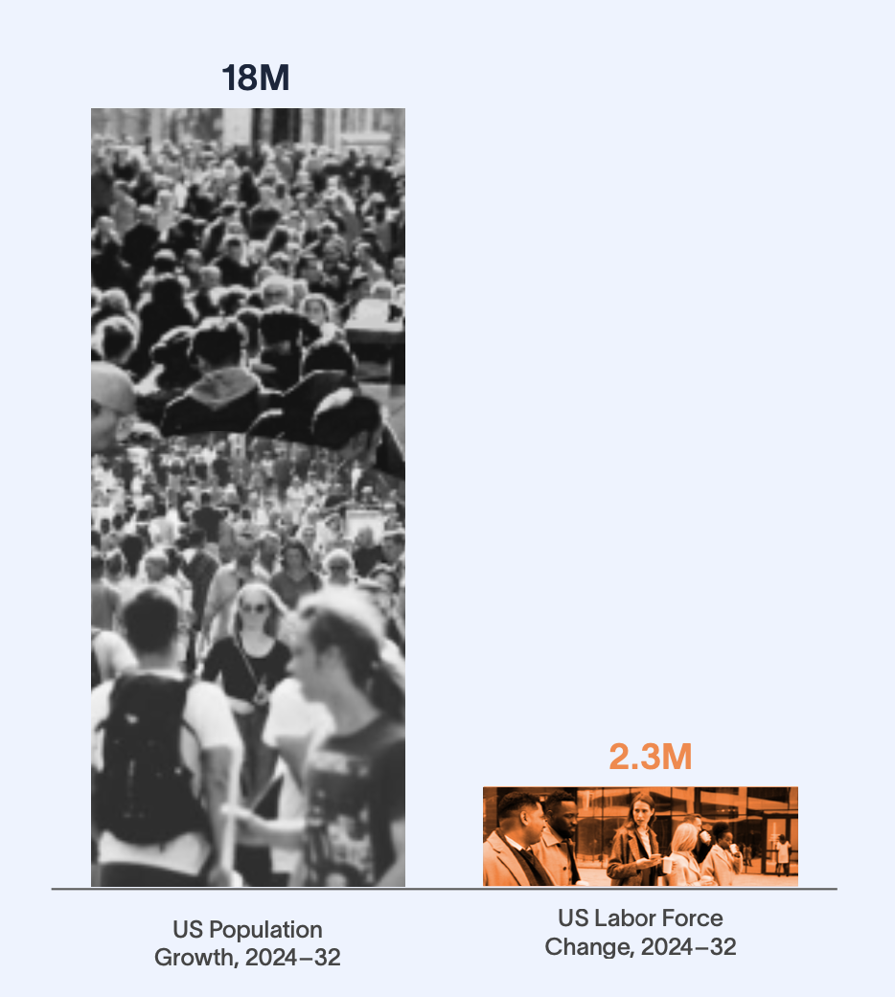

From 2024 to 2032,
US Population Growth Will Outpace Labor Force Growth by Nearly
8 to 1.
THE RISING STORM

Slide 15
Increase in Consumers
Increase in
Producers
THE RISING STORM

Slide 16

What’s Happening?

Slide 17
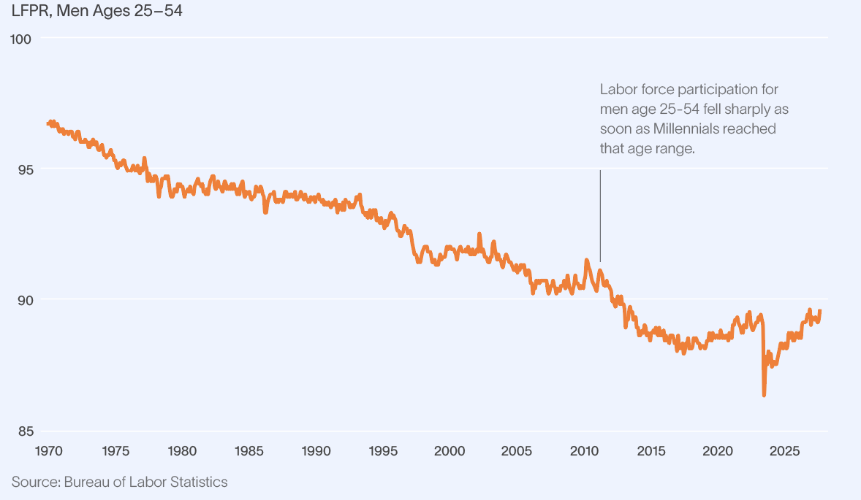
Prime-Age Male Workforce Participation Has Plummeted.

Slide 18
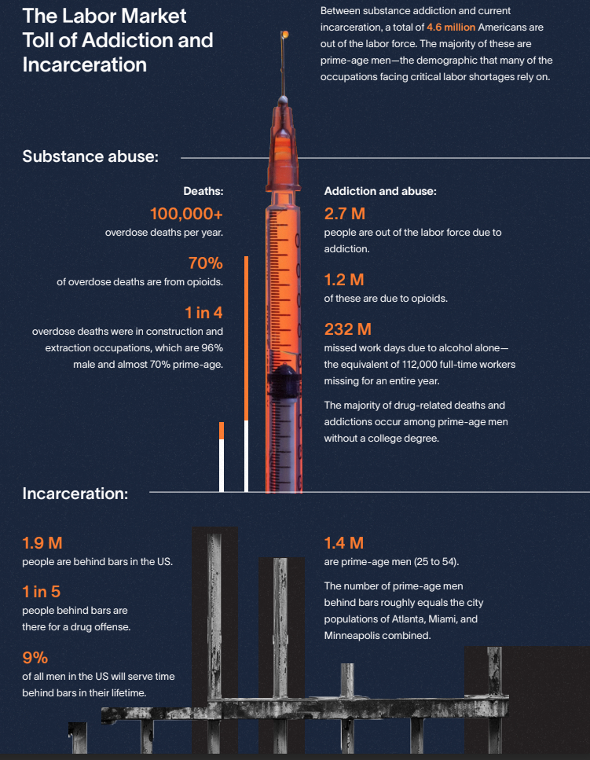

The Labor Market Toll of Addiction and Incarceration
Between substance addiction and current
incarceration, a total of 4.6 million Americans are
out of the labor force. The majority of these are
prime-age men—the demographic that many of the
occupations facing critical labor shortages rely on.
Among those that have served time behind bars, 60% are still without a job a year after their release. And the overall unemployment rate for those formerly incarcerated sits at a whopping 27%-- almost 7 times higher than that of the general population

Slide 19
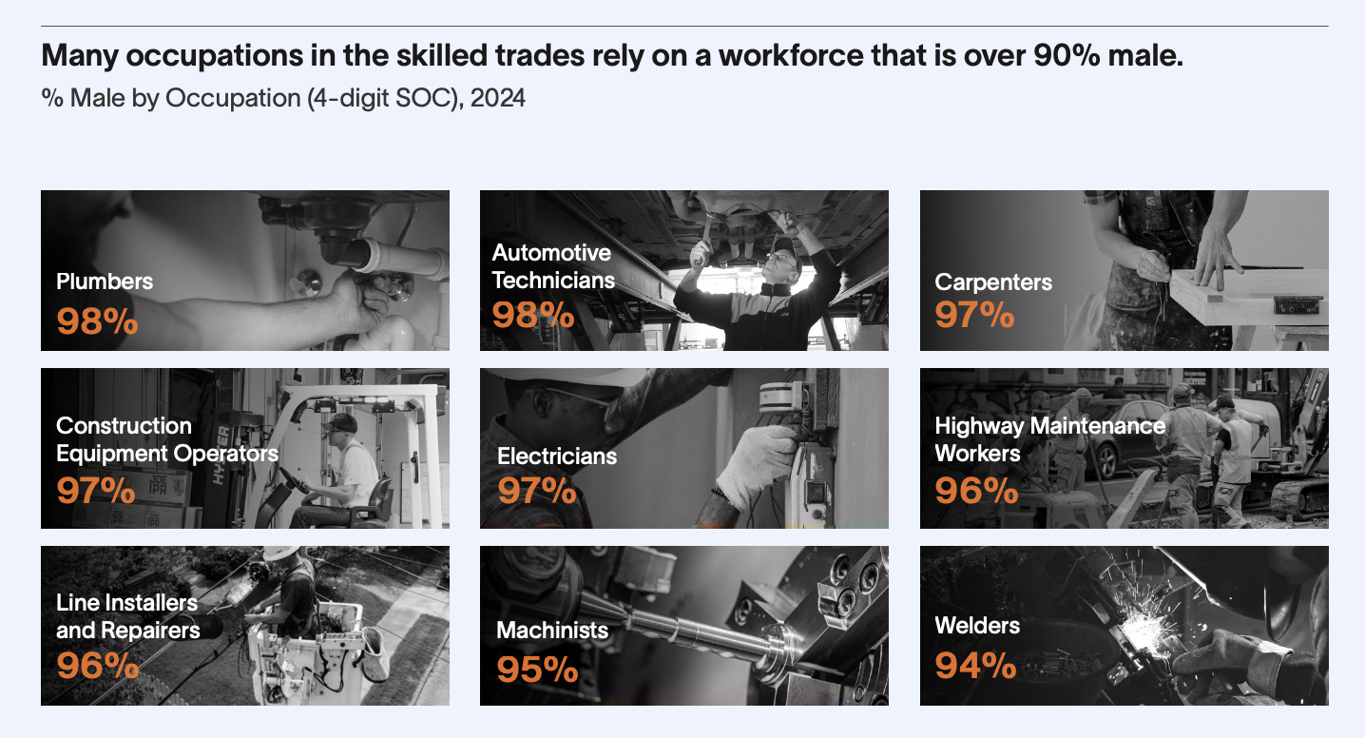
THE RISING STORM

Slide 20
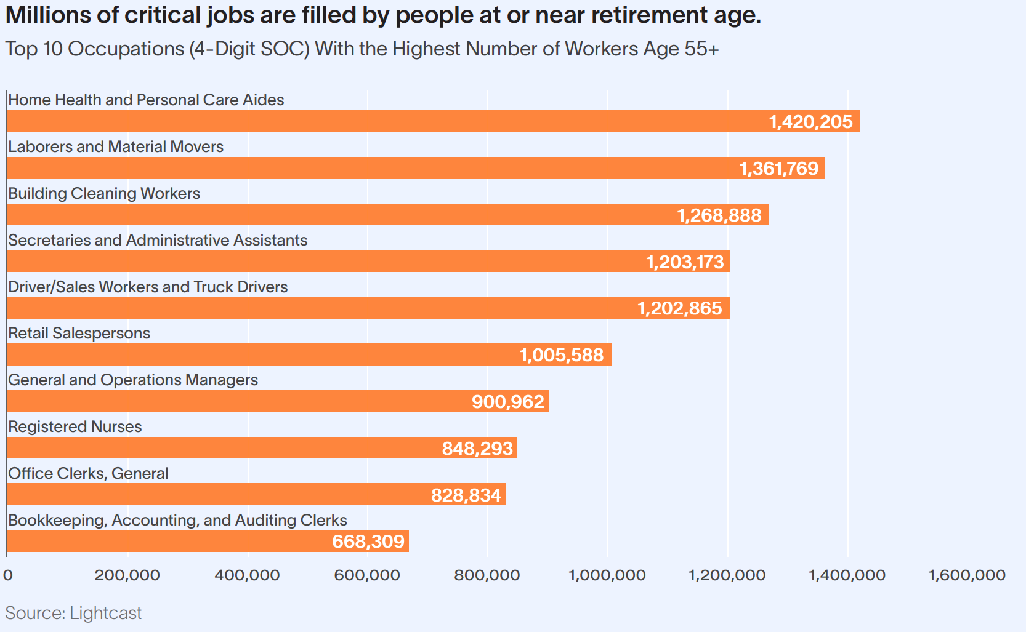

Slide 21
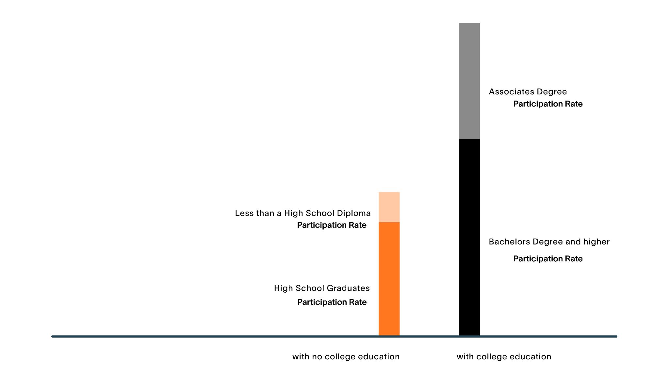
The U.S. is Already Highly Educated
36M
63%
And more highly educated people have a greater labor force participation rate
9M
65M
48%
36M
73%
57%
43M
101M
THE RISING STORM
Source: BLS, CPS Table A-4

Slide 22
But…
Roughly 60% of All Open Jobs do Not Require a College Degree.

Slide 23
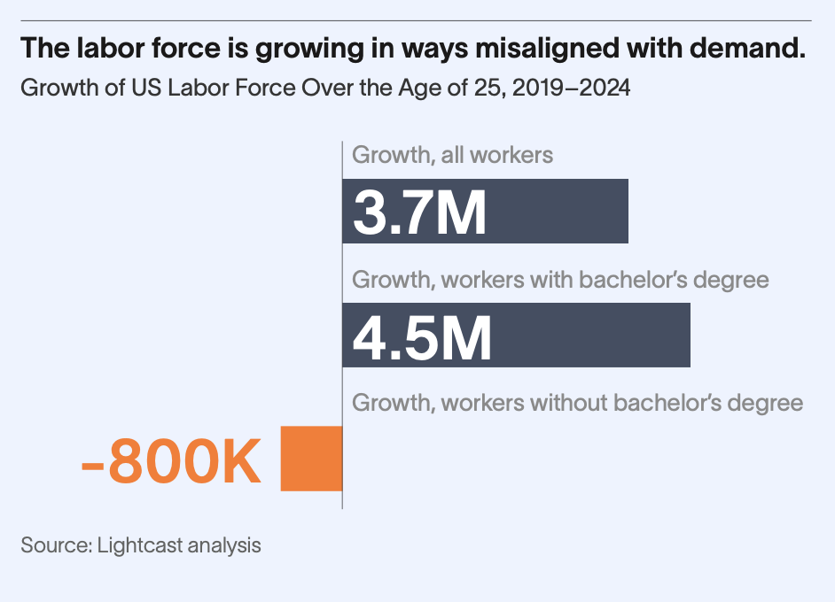
THE RISING STORM

Slide 24


Where Yakima Stands
THE RISING STORM

Slide 25
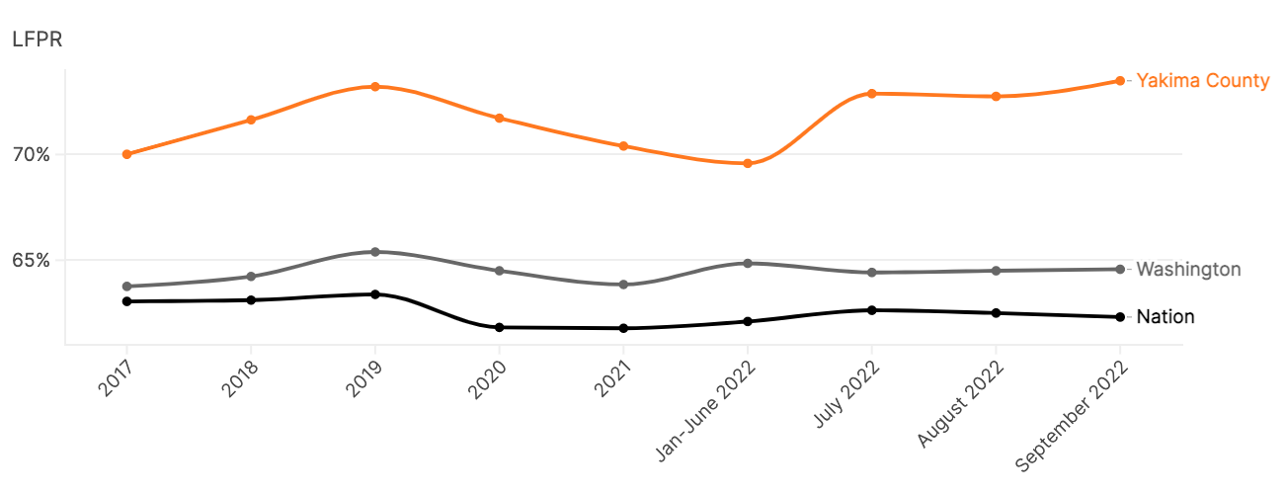
Labor Force Participation Rate
Yakima County • Washington • United States
2023

Slide 26
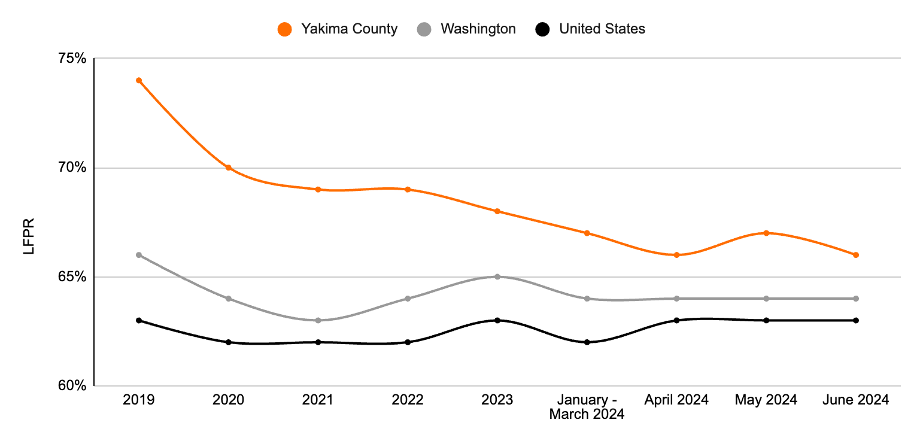
Labor Force Participation Rate
Yakima County • Washington • United States
Today

Slide 27
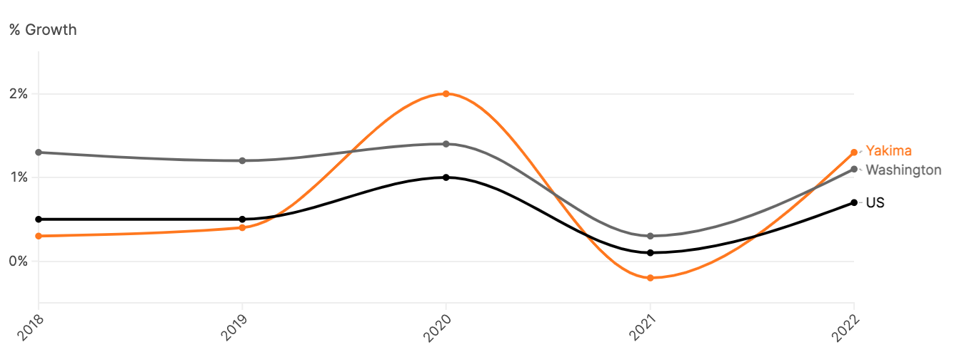
YoY % Population Growth
Yakima County • Washington • United States
2023

Slide 28
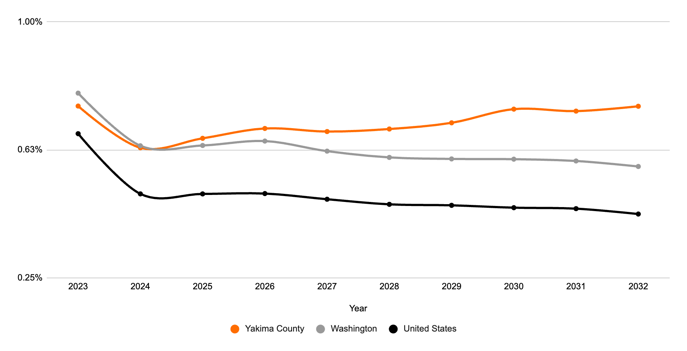
YoY % Population Growth
Yakima County • Washington • United States
Today

Slide 29
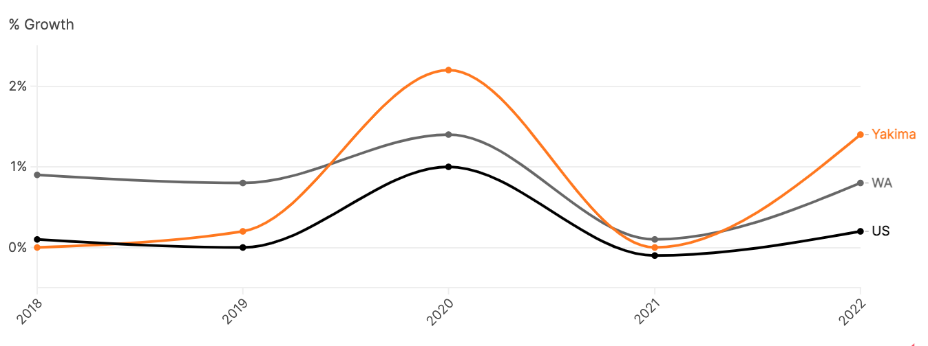
YoY % Working Age (15–64) Population Growth
Yakima County • Washington • United States
2023

Slide 30
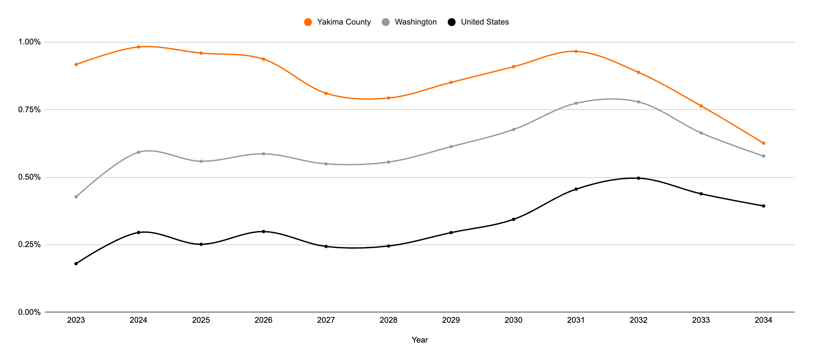
YoY % Working Age (15–64) Population Growth
Yakima County • Washington • United States
Today

Slide 31
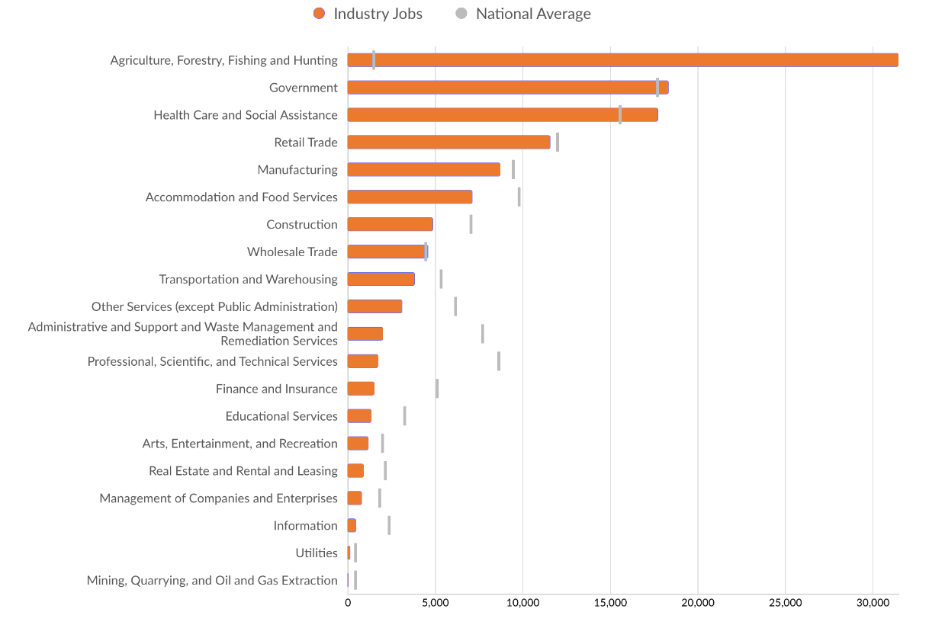
Large Industries
Yakima, WA
Notes:
21.6 times more ag jobs than the national average

Slide 32
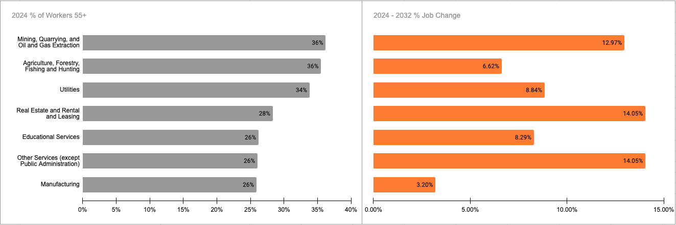
Yakima Industries with High Retirement Risk
Several industries have more than 1 in 4 workers who are 55+

Slide 33
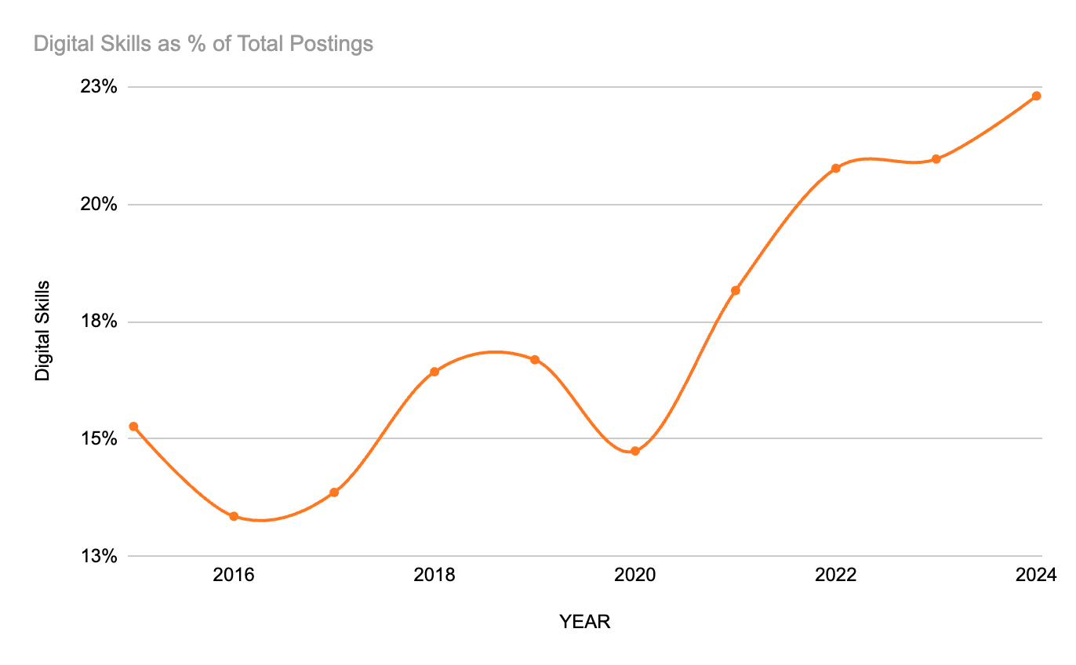
According to research from National Skills Coalition and Federal Reserve Bank of Atlanta, in the state of Washington:
95% of Healthcare Postings
90% of Arts, entertainment, and recreation Postings
86% of Agriculture, forestry, hunting
Yakima In Demand Skills and Rise of Digital Skills

Slide 34
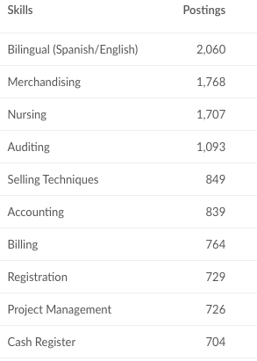
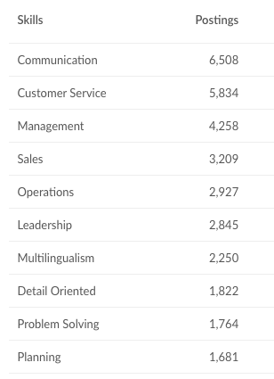
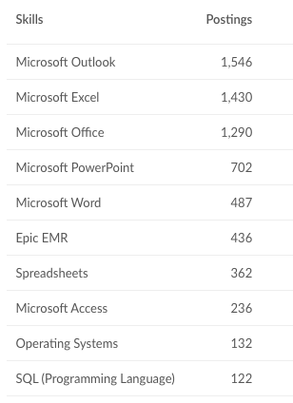
Yakima In Demand Skills and Rise of Digital Skills
Specialized Skills
Human Skills
Digital Skills

Slide 35
So, Where do we go from here?

Slide 36

IMMIGRANTS?
Who’s Gonna Do This Work?

Slide 37
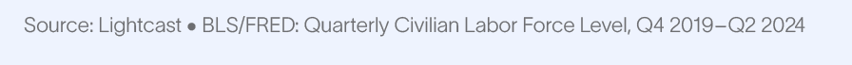
Immigration is The One Source of Talent That is Keeping The US Labor Market Afloat.
Since late 2019...
102%
of the 3.7M increase
in the US labor force
was foreign-born.
In that time,
the US-born
labor force
dropped by
73K

Slide 38
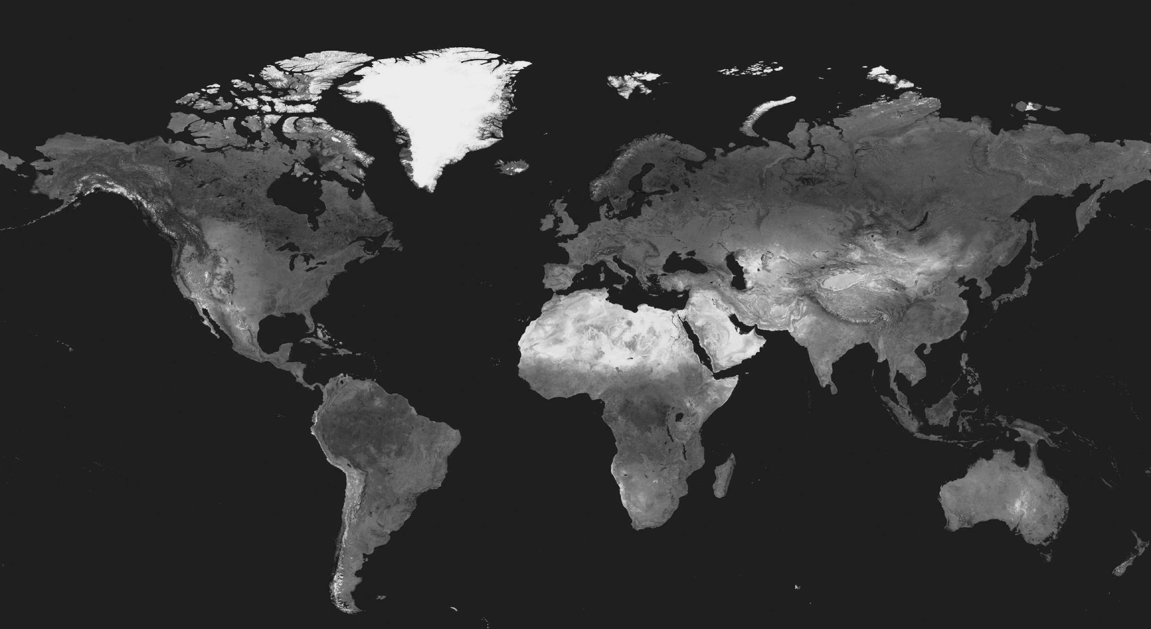
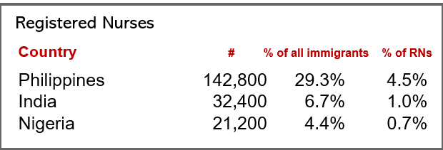
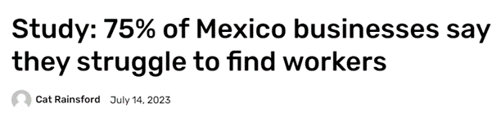
But What if it Can’t?
Birth rates have been falling and labor shortages growing around the globe— including in countries the US relies on for its workforce.
Mexico has a much lower unemployment
rate than the U.S.
The Philippines currently has a shortage of 100,000 nurses. Starting in 2021, they started placing strict limits on those who want to emigrate.

Slide 39

Hiring Requirements?
Who’s Gonna Do This Work?

Slide 40

Revisiting Hiring Requirements
Educational Requirements:
  73% of the Yakima population doesn’t have a college degree.
  47% of Washington Postings and 45% of Yakima Postings since January require college degree
Justice Involved:
  4,000 job postings since January implicitly or explicitly felon friendly in State of Washington
  Estimated over 250,000 openings this year for the same occupations - State of Washington

Slide 41
Artificial Intelligence and Digital Skills?
Who’s Gonna Do This Work?

Slide 42
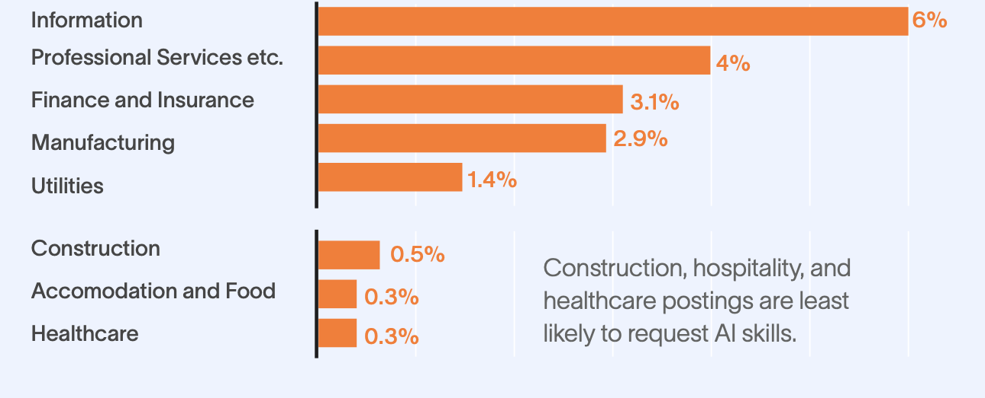
AI skills are in highest demand in industries with low danger of talent shortages.

Slide 43

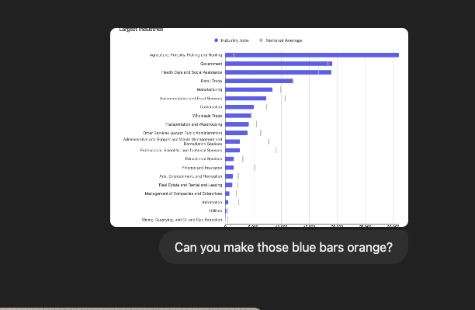

Slide 44


SCAN
Joshua LaFon
joshua.lafon@lightcast.io
https://www.linkedin.com/in/joshualafon/
To Download
The Rising Storm

Slide 45
Thank you.

