Slide 1
Taking Bias out of the Box: How Curiosity Can Help Address Recruitment

Slide 2
MY GOALS
Not to teach you anything!!!
Make you
Smile
Think
Feel

Slide 3
What I’ll share with you
Executive Summary
My Story
A Troubling Cycle
Second Chance Hiring Benefits
The Solution to Overcoming Bias
More Effective Second Chance Hiring
Giveaway (money is involved)!
Final Thought

Slide 4
EXECUTIVE SUMMARY
The US has an incarceration problem, which leads to employment and recidivism issues
There is already EEOC guidance about how employers should treat job seekers with criminal convictions

Slide 5
EXECUTIVE SUMMARY
There are significant benefits to hiring from this talent pool
There are many very easy (and free) ways to improve your hiring practices for these applicants

Slide 6
My Story

Slide 7
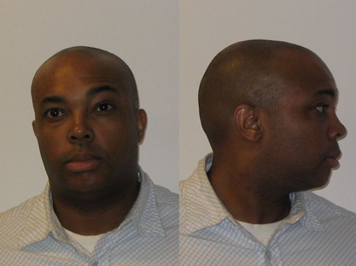
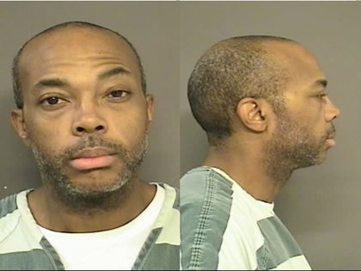
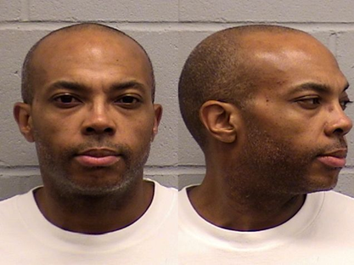
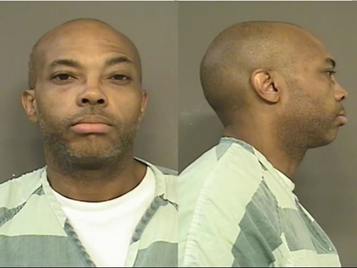
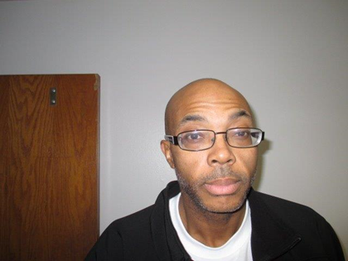
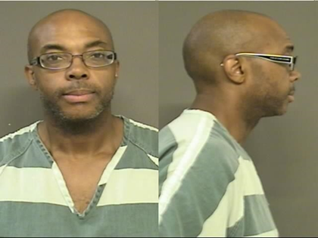
How It Was

Slide 8
A troubling cycle

Slide 9
THE US HAS A CRIMINAL JUSTICE ISSUE
600K
77M
11.4M
6K
2M
95%
98K

Slide 10
LEADS TO NEGATIVE JOB OUTCOMES
60% of people who were incarcerated are unemployed one year after release
64% of unemployed men in their 30s have a criminal record
60% higher call back rates for those without criminal convictions

Slide 11
WHICH INCREASES RECIDIVISM
The #1 reason for re-offense is poverty
WA State spends about $241M per year on recidivism
Recidivism impacts feelings of safety, community, and vibrancy

Slide 12
Benefits

Slide 13
Second Chance Hiring Benefits
Lower Turnover Rates/Higher Retention
Taxpayer Savings and Tax Benefits
More Competitive Workforce
Increased Diversity
Stronger and Safer Communities
Notes:
Other studies have shown that second chance hires stay on average about 13% longer than non second chance hires. Why is that?...

Slide 14
The solution to overcoming bias

Slide 15
How to Use Curiosity?
Companies do well with the first question
Most important question is the second one
Notes:
What does that mean for employers who are looking to fill many positions? It means that it might be time to rethink how we treat applicants with criminal convictions.
The serach for employment for those with criminal convictions looks the same regadless of geigraphy all across the nation. If an individual gets an interview and does well, once the background check is run, then the conversation changes. The focus moves away from whether the applicant is qualified and moves entirely to focusing on the criminal background and those last two boxes I mentioned before show up.
The problem with this is that background checks are backward looking. They tell you nothing about the person you are interviewing today.
Here is where curiosity has to enter the conversation. Employers do a great job of asking the first question when they encounter an applicantwith criminal convictions. It’s usually some form of:tell me what happened with this criminal conviction or convictions.
But I say employers need to slow down and ask a more important second question: “What’s been happening in your life since these things occurred?” And then just let the applicant talk, and you can notice some things. Did they tell you’d find some items in their background? When they tell their story or present you with a letter of explanation, are they taking accountability for what happened or blaming others? Have they done some things like enter recovery, get counseling, go back to school, volunteer, or work other jobs? Do they have verifiable referrals or letters of recommendation?
These are all important things to consider when evaluating someone with past criminal convictions to see if the person sitting across from you tdoay, is different than that person from before.
But so often, because of company policies, fear, and ignorance, most companies never get to this step.

Slide 16
EXERCISE
9-minute exercise
Get into groups or 2 or 3 – 1 minutes
Come up with a good second question – 3 minutes
Quick report out – 5 minutes
Notes:
What does that mean for employers who are looking to fill many positions? It means that it might be time to rethink how we treat applicants with criminal convictions.
The serach for employment for those with criminal convictions looks the same regadless of geigraphy all across the nation. If an individual gets an interview and does well, once the background check is run, then the conversation changes. The focus moves away from whether the applicant is qualified and moves entirely to focusing on the criminal background and those last two boxes I mentioned before show up.
The problem with this is that background checks are backward looking. They tell you nothing about the person you are interviewing today.
Here is where curiosity has to enter the conversation. Employers do a great job of asking the first question when they encounter an applicantwith criminal convictions. It’s usually some form of:tell me what happened with this criminal conviction or convictions.
But I say employers need to slow down and ask a more important second question: “What’s been happening in your life since these things occurred?” And then just let the applicant talk, and you can notice some things. Did they tell you’d find some items in their background? When they tell their story or present you with a letter of explanation, are they taking accountability for what happened or blaming others? Have they done some things like enter recovery, get counseling, go back to school, volunteer, or work other jobs? Do they have verifiable referrals or letters of recommendation?
These are all important things to consider when evaluating someone with past criminal convictions to see if the person sitting across from you tdoay, is different than that person from before.
But so often, because of company policies, fear, and ignorance, most companies never get to this step.

Slide 17
How to evaluate these job seekers

Slide 18
EEOC 2012 Guidance
Using criminal history may be a violation under Title VII of the Civil Rights Act of 1964
Says that employers should use the “nature-time-nature” test to evaluate applicants’ fitness
Include an individualized assessment

Slide 19
INDIVIDUALIZED ASSESSMENT TIPS
Absolutely, positively do not use your gut
Do not let one bad hire ruin your attitude
Get more than one person included in the evaluation or have a system
Ask questions that uncover their life since the last conviction

Slide 20
Where to find this talent

Slide 21
Where to find the workers?
Workforce development system
Other government agencies
Local nonprofits
Parole and probation officers
Flow of applications

Slide 22
How to implement practices

Slide 23
Low effort
Follow the EEOC guidance
Fairly consider job seekers through the natural flow of applications

Slide 24
medium effort
Add a blurb to your EEOC statement in your job postings, employee handbook, and website
Internally publish your disqualifying offenses for criminal history and share those policies with applicants before performing preemployment background checks

Slide 25
high effort
Analyze every position in your company to seek opportunities for those with criminal convictions
Appoint more than one person to hire and evaluate these job seekers
Establish relationships with CBOs and government agencies that serve those with criminal convictions

Slide 26
MY GOALS
Not to teach you anything!!!
Make you
Smile
Think
Feel

Slide 27
Notes:
Sources: Harvard Policy Center, What’s Next WA, Wa State Patrol, US Dept of Health and Human Services

Slide 28
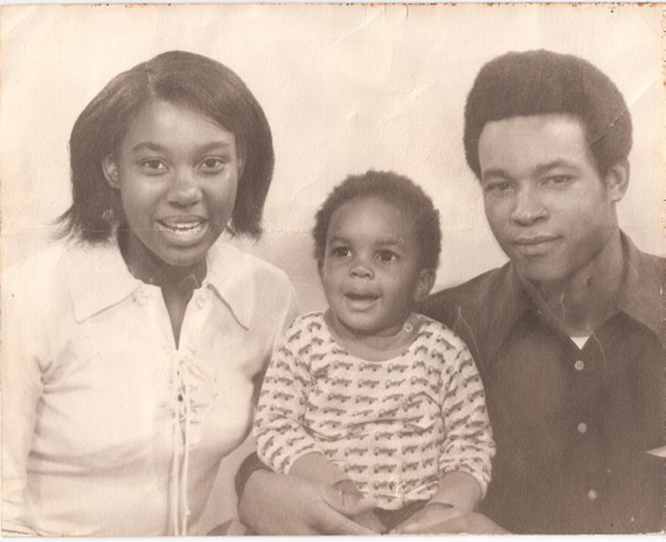
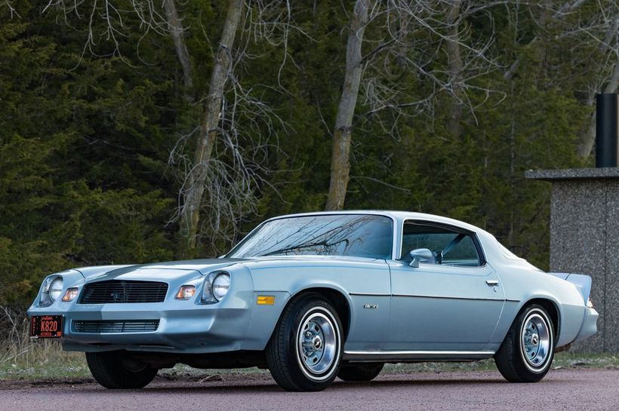
A FINAL THOUGHT
Notes:
Sources: Harvard Policy Center, What’s Next WA, Wa State Patrol, US Dept of Health and Human Services

Slide 29
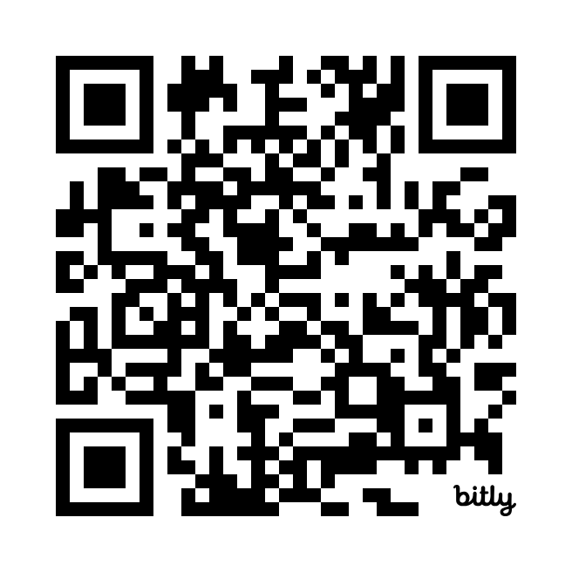
ONLINE COURSE FOR SERVICE PROVIDERS
Notes:
Sources: Harvard Policy Center, What’s Next WA, Wa State Patrol, US Dept of Health and Human Services

Slide 30
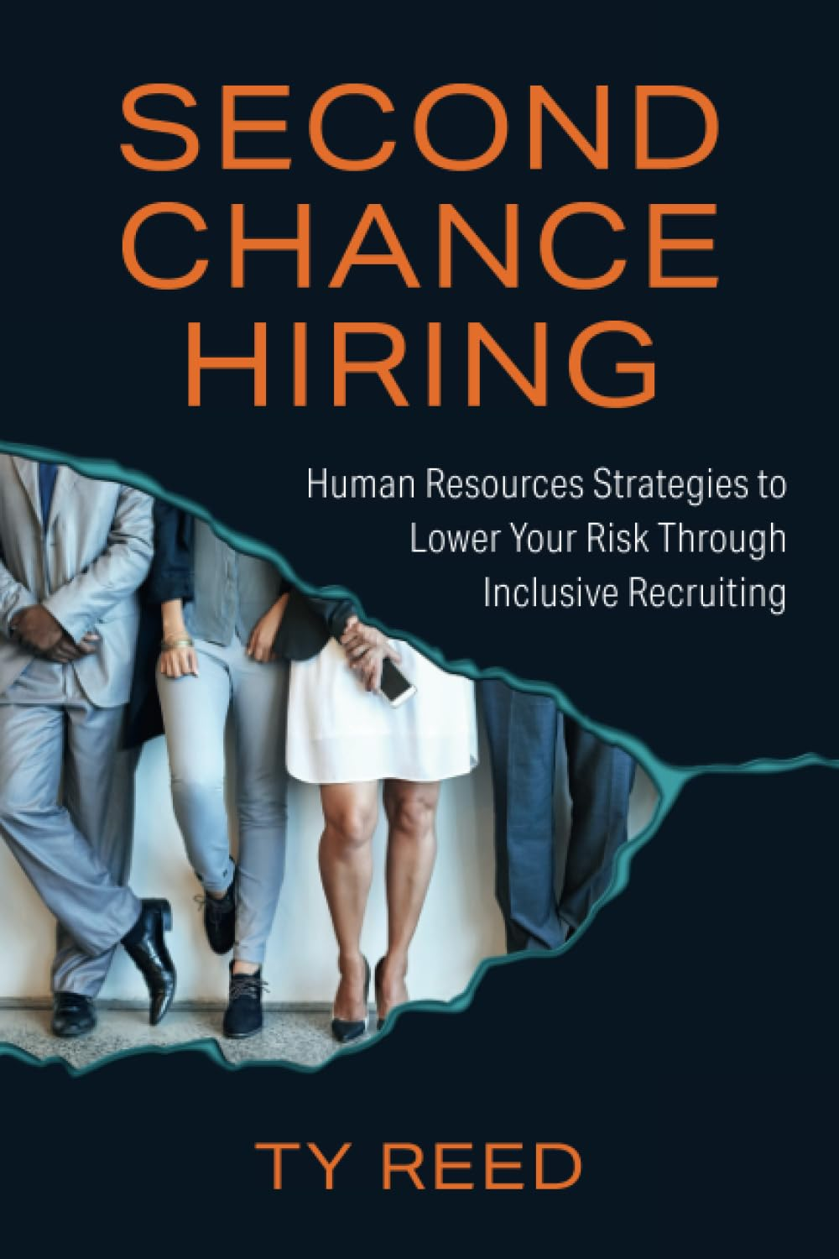
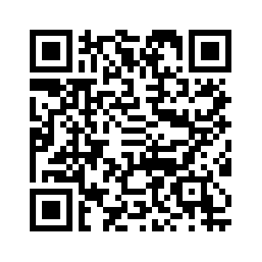
I wrote a book!
Notes:
Sources: Harvard Policy Center, What’s Next WA, Wa State Patrol, US Dept of Health and Human Services

Slide 31
For more info, to find help, donate, or see data and resources
Ty Reed
Recovery Career Coach
ty@recoveryandwork.org
https://www.linkedin.com/in/tyreedmba
recoveryandwork.org

