Slide 1
Skills-Based Hiring and Apprenticeships
Developing Workforce Pipelines and Making Them Stick
Julie Orchard, Service Area CHRO
2024 Yakima County Workforce Conference: Untapped Talent October 29, 2024
Notes:
Skills-based Hiring and Apprenticeships Developing Workforce Pipelines and Making Organizational Hiring Initiatives Stick
​
In this session you will learn how to identify a staffing need inside your organization. Then we will cover how to begin a pipeline into that job and how to find resources in your community to partner with to help fill the pipeline in your organization. Tried and true programs will be shared (from a healthcare setting) that can be applied to any organization.

Slide 2


Start
Notes:
So how do you eat and elephant – fist – gross and second – one bite at a timeI know when I started to think about this work, I was excited yet it seemed a mountain of work. IT WAS SO worth it!!! You sitting here today – just starting to think about a pipeline – you are already a head of those that aren’t here. One step at a time! It is do-able!

Slide 3
Define Your Highest Need Role
Who Are Your Partners
Build Your Pipeline
Notes:
Today we are going to walk through how we built our pipelines with actual positions, costs and some slides we used to sell our vision. So how do you eat and elephant – fist – gross and second – one bite at a time. So we first Defined our highest need – we needed to uncover what jobs needed the most attention. Then we built our data story around those positions and you’ll see what we took into consideration to build the case. Then, intertwined in all of that was the solve. By a approaching the task this way, we were really investigating the solve while building our story. So lets start with the need.

Slide 4



What are your hot jobs?
County | Occupation (SOC) | Total postings
Yakima County, WA | Registered Nurses | 327
Yakima County, WA | Retail Salespersons | 76
Yakima County, WA | Health Technologists and Technicians, All Other | 75
Yakima County, WA | Medical Assistants | 42
Yakima County, WA | Customer Service Representatives | 39
Yakima County, WA | Fast Food and Counter Workers | 37
Yakima County, WA | First-Line Supervisors of Retail Sales Workers | 36
Yakima County, WA | Heavy and Tractor-Trailer Truck Drivers | 33
Yakima County, WA | Secretaries and Administrative Assistants, Except Legal, Medical, and Executive | 32
Yakima County, WA | Licensed Practical and Licensed Vocational Nurses | 31
Define your highest need position
Highest Number of Openings
Trend for that Position
Do we have High Turnover
Does the Market Support
Yakima County Statistics August 2024
Notes:
So we started to dig in. We started looking at vacancy rates – remember vacancy rate measures the percentage of vacant positions over a specific period of time. If you have 5 hot jobs and you measure your vacancy rate – you should be able to identify pretty quickly, which job you’ll need to focus on. Then you need to ask about the availability of talent in the area. Then layer that in with turnover rate for each of your hot jobs and last but not least, let’s not forget the bubble of folks that might be retiring in 2-5 years. This is a guess, but pulling that number (ee’s ages in that role to forecast) helps you identify how many you will need to fill your pipeline in order to fill the positions needed.

Slide 5
Develop your Data Story (the work)…
What is the story you are telling?
What is the data you need to gather to satisfy the stakeholders you’ve identified?
    Position Growth
    Turnover
    Demand Profile
    Cost

Slide 6


Provider & MA Growth
60+ medical clinics and over 800 providers – in the Spokane, Colville, Chewelah and Lewiston area.
 | 2012 | 2013 | 2014 | 2015 | 2016
APP | 58 | 151 | 182 | 195 | 220
MD | 199 | 266 | 307 | 350 | 382
Total | 257 | 417 | 489 | 545 | 602
MA Growth
2012 – 103
2013 – 180
2014 – 199
2015 – 239
2016 – 279
Notes:
This is just an example of what we did at Providence to help prove the need going forward.

Slide 7
Define Your Highest Need Role
Who Are Your Partners
Build Your Pipeline

Slide 8
Internal and External Stakeholders
INTERNAL STAKEHOLDERS
C-Suite
Directors
Managers/Operators
Operators
Workforce/Trainers
EXTERNAL STAKEHOLDERS
Education Partners
    Think outside the box – technical schools, alternative colleges, programs outside educational institutions
WorkSource Partners
    Data, analytics, workforce
Because you will need:
Recruiters
Trainers/Preceptors
Communications
Leaders

Slide 9
Engaging others in the solution
Work with subject matter experts to test your theory. What is their view on the workforce issues you are facing?
Notes:
Who are the internal and external stakeholders who will help sell the pipeline or might be a very big nay-sayer to your proposal. It’s really important to identify them, write their names down and get to the business of communicating with them. Bring them on board to help in the solutions. You’ll find some of these folks will be natural champions of your work. It will be really handy to have a different voice then you when you are selling this idea.
IMPORTANT – test your theory with subject matter experts. This is critical. There are things we don’t know because we do not perform that job so work this pipeline idea through with a leader who has done that job recently and understands some of the barriers that might be in your way.

Slide 10






How Are You or Your Teams Building Relationships
Notes:
Are you building relationships with boards in your area who work in the space of workforce.
Are you partnering with schools at early levels
Are you working with technical schools to entertain new programs or work with defined programs.
What is happening at the State level that can help propel your pipeline or that you can find grant money to assist your build?
You’d be surprised at what is out there already.

Slide 11
What Are The Advantages?
Committed to your community
Bettering education programs
Willingness to commit personal time
Hear things first
Sharing your struggles with industries workforce
Resources for solutions
Notes:
The advantages of getting involved in these types of organizations.
Showing up show that you are committed to your community
Because you as a business are partnering, the interest level from all parties rise because you are present.
Sharing your struggles starts the process of innovation. How can we solve this problem.

Slide 12
Define Your Highest Need Role
Who Are Your Partners
Build Your Pipeline

Slide 13
Solution
Solve with Viable Pipelines
Recruiting Strategy
    Education Partners
    Community Partners
Build Sustainability
    Timebound Agreements
    Career Path Advancement
Training Options
    External
    Internal
    Timelines, Requirements
Notes:
To build your pipeline, you need to partner with your internal and external stakeholders to pull it all together.
Your HR partners in recruiting can help support your efforts.
Training options – consider internal on boarding and external options. External options might be the school partnership offers professionalism class or mock interviews.
Be clear on timelines. When are students graduating and coming into your program. Graduation could be from High School, Alternative program., Community College or College.
Let’s talk a little more about the time bound agreements.

Slide 14
Earn-To-Learn programs with Retention Agreements
Learning:
Remove barriers by paying students to gain an education (student pay) and by paying for cost of the educational program “up front”… which, can be used to build retention and loyalty.
Notes:
What is an earn to learn program. Speak to the MA program and how that worked. Time bound agreement upon hire that they will work two years once they have obtained their Certification or completed their program – fully.
Our goal was to end generational poverty – what could we do and what could we ask in return.

Slide 15
Earn-To-Learn programs with Retention Agreements
Things to Consider…
Cost of Program per Student
    High Cost/Longer Term Agreement
    Low Cost/Shorter Term Agreement
Market Considerations
    Other programs that are similar in market area
    Success of attracting applicants
Reasonable for Student
    Are we asking too much, too little?
Time-bound agreements
Notes:
Calulate the full cost of the program per student.
-Cost of training
-Cost of preceptor
-Cost of equipment
NOTE – Once they obtain a license or certification, this is theirs to maintain. It is a good practice that they pay this – IF THEY can. If it become a barrier, pay it.
Time-bound agreements consist of acknowledgement of an obligation to stay a certain length of time understanding that the organization has spent time and money into an education or certification that you can take elsewhere.

Slide 16
Putting it all together

Slide 17


Successful Pipelines
    Make the program replicable
      What other positions in your organization would benefit from this program?
    At Providence:
      Nurse Tech (Pre RN)
      Medical Assistant
      Certified Nursing Assistant
        ESL – NAC Program
      Phlebotomist
Notes:
We just completed our first class of English as Second Language class of Nac’s This was in partnership with our Spokane Workforce Council who provided funds to help with housing and daycare. 10 graduates (Kenya, Bostwana, Jamaca, Ukraine..etc). Totally committed to Providence for given them the opportunity.

Slide 18
Thank You!
Julie Orchard
CHRO – Providence INWA Service Area julia.orchard@providence.org

Slide 19
Appendix

Slide 20


1st DOH – approved “Acute” NAC Training Site
2 teachers; 1 core leader
Continuous cohorts of 10 students each
13-week paid program
Approx. 120 students per year for our 3 primary hospitals in Spokane
Providence Jobs - Student Nursing Assistant (providenceiscalling.jobs)

Slide 21
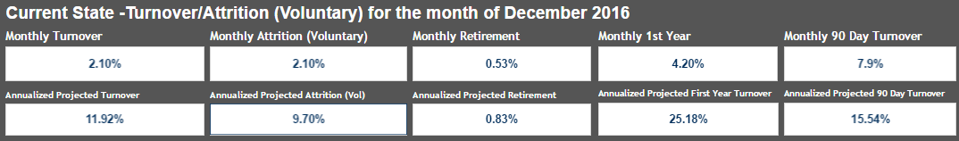
MA Turnover…
BF
PMG MA Population as of 1/30/2017 – 274 (254.5 FTE)
Annualized Projected Turnover (current population) - 33
MA Position Category has 25% 1st year turnover.
This is an area we need to work on targeted improvement due to impacts on provider productivity and costs to the business.

Slide 22


Supply – Spokane Area MA Programs
BF
MA Program (Source) | MA Classes & Volumes | Total potential graduates
Carrington College ($15k) | Continuous Wheel program with new STARTS every 6 weeks. 20-30 students each new start cycle. | 28-30 every 6 weeks (8 per year @ 78% completion rate) = up to 187 per year
SCC – Spokane ($6k) | Quarterly Cohorts in Spring, Summer and Winter (distance ed program). | 16 – March starts 30 – June starts 16 – Dec Starts (90% completion rate) = up to 56 per year
Total MA Students Annually – up to 243

Slide 23
Can you define your outcomes?
Learning…
Take the time to complete full research with your community partners and current offerings in the market. It informs everything else.
Example(s): local Community College; WACH; high schools & tech programs; work source.
What are expectations of stakeholders?
Do you have a problem statement you agree on?
Do you have specific goals/targets?
What can be barriers to implementation?
    Financial
    Attitudinal
    Structural

Slide 24
MA Apprentice (2017 Pilot of 8)
1yr cost
BF
Be ready to scale the size and scope of your pipeline up or down.
Have a pilot with less students as an alternative in your back pocket.

Slide 25
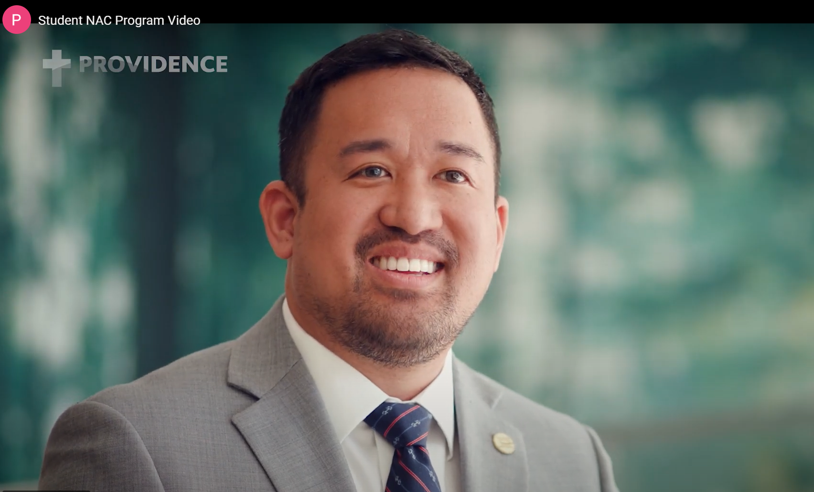

VIDEO Evidence
Notes:
https://youtu.be/ad4dmhPoYGM
https://youtu.be/kE9A6DP2Cyw
Providence Medical Assistant Apprenticeship video | Interested in becoming a Medical Assistant Apprentice through Providence Medical Group? Check out this video to learn more! | By Next Generation Zone | Facebook

Slide 26
Appendix

Slide 27
What is YOUR Hot Job? (Identify one: ___________)
JO
What position has the highest number of openings?
How many of these positions do you currently have?
Has the number of positions needed inside your organization grown over the past 3-5 years?
What projections in retirement in this role are you seeing?
What is the position you need to address?
Problem Statement:
There are not enough trained MA-C’s available in the market to improve patient access and provider productivity concerns. A new pipeline is needed to augment current practices and improve retention of MA-C’s we are investing in.
Notes:
Here is a worksheet for you to get your basics down. You’ll need all this information again when you build your data. And develop your problem statement. It will help you focus in on what you need to solve for and the more clear YOU are on that the more clearly you’ll be able to communicate to the decision makers.
Pass to Bryan to develop the data story.

