Slide 1
20
24
AARP Washington
Finding Opportunity in
an Aging Workforce
www.aarp.org/wa

Slide 2
Understanding the Changing Demographic
By 2030, more people will be over 65 than under 18. All systems need to change. Including employment.

Slide 3
Older Adults in the Workforce
Older adult employment rates are increasing because of:
•Improvements in educational attainment
•Improved physical health
•Declines in the prevalence of physically demanding jobs
•Increases in the Social Security retirement age
•Need for social connection and inclusion
Source: Urban League

Slide 4
However,
Older adults are overrepresented among discouraged workers
Workers 55+
Workers 25 - 54
Those ages 55 and older represented 27% of discouraged workers, but only 23% of the labor force
Younger adults ages 25 to 54 were underrepresented among discouraged workers, representing only 51% of discouraged workers but 64% of the labor force.
Source: Bureau of Labor Statistics
Notes:
However, employment rates may understate the desire to work at older ages because those figures do not count people who cannot find jobs or become discouraged in their job searches and drop out of the labor force.
Older adults are overrepresented among discouraged workers (adults out of work and not actively looking for work because they believe there are no jobs).
In 2019, those ages 55 and older represented 27 percent of discouraged workers but only 23 percent of the labor force. In contrast, younger adults ages 25 to 54 were underrepresented among discouraged workers, representing only 51 percent of discouraged workers but 64 percent of the labor force.
(Source: Bureau of Labor Statistics)

Slide 5
1) Being passed over for promotions
Age Discrimination in the Workforce
2) Lack of flexibility for caregiving responsibilities
Encouraged to retire early
3) Perceived lack of skills or abilities to learn new skills
4) Lack of opportunities to share knowledge and experiences

Slide 6
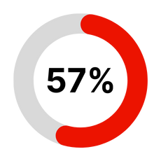
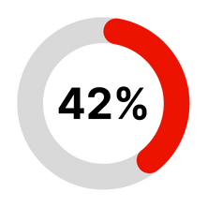
Importance of Providing Additional Education
Research shows that 57% are willing to learn new skills if requested by their current or a potential employer
42% are interested in receiving additional job or skill training of any kind if it were available for free
Despite the willingness to learn new skills, 66% say that they did not participate in any job-related training or education in the past 2 years

Slide 7
Importance of Providing Additional Education Continued
• Among those who did participate in job-related skills training or education programs in the past two years (32%),
• One in ten took computer or other technology training (12%)
• Continuing education classes (10%).
• Computer or other technology training (47%)
• Foreign language (32%),
• Professional skills training (24%)
• General continuing education (24%)

Slide 8
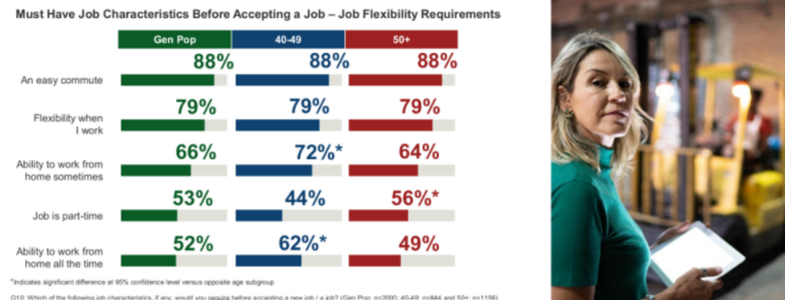
What Is the Older Worker Looking for in Employment Opportunities?
Source: Urban Institute
Notes:
Importance of social connection

Slide 9
Senior Community Service Employment Program
The nation's oldest program to help unemployed people over 55 find work.
Matches eligible older jobseekers with local nonprofits and public agencies.
AARP
Programs
Back To Work50+
• Free workshops, coaching and resources that can help people over 50 compete in workplace.
Work for Yourself @50+
• Explore self-employment options to increase financial stability.
• Start a business.
• The Work for Yourself@50+ Freelancing Resource Center.
Digital Skills Ready@50+
Free digital skills courses for people over 50 to increase digital knowledge.
A library of online resources to gain quick digital tips.
Learn More Here
Notes:
Senior Community Service Employment Program (SCSEP)
The nation's oldest program to help unemployed people over 55 find work.
Matches eligible older jobseekers with local nonprofits and public agencies so they can increase skills and build self-confidence while earning a modest income.
BACK TO WORK50+
Offers free workshops, coaching and resources that can help people over 50 compete in today’s fast-changing workplace.
Provides the training, coaching and job-readiness tools needed to compete with confidence for today’s in-demand jobs.
Work for Yourself@50+
Makes it easy for adults to explore self-employment options to increase their financial stability.
WFY partners provide information guiding participants on what it takes to start a business that's right for them.
The Work for Yourself@50+ Freelancing Resource Center provides support to both first-time freelancers and experienced independent workers.
Digital Skills Ready@50+
Provides free digital skills trainings through community partners for people over 50 who are looking to increase their digital knowledge and literacy.
Offers a wide selection of courses designed to equip adults with the essential digital skills needed for success in today’s dynamic workforce.
Has a library of diverse online resources to help older adults gain quick and easy-to-understand digital tips.

Slide 10
Policy & Other Opportunities
“Aging is SO popular...We are all doing it”
Multi-sector Plan on Aging
Valuing the wisdom and experience of older adults
Re-thinking the Caregiving Workforce
Older Adult Workforce Opportunity
Supporting Training Opportunities
Improving the reporting of age discrimination
Promoting multi-generational approaches

Slide 11
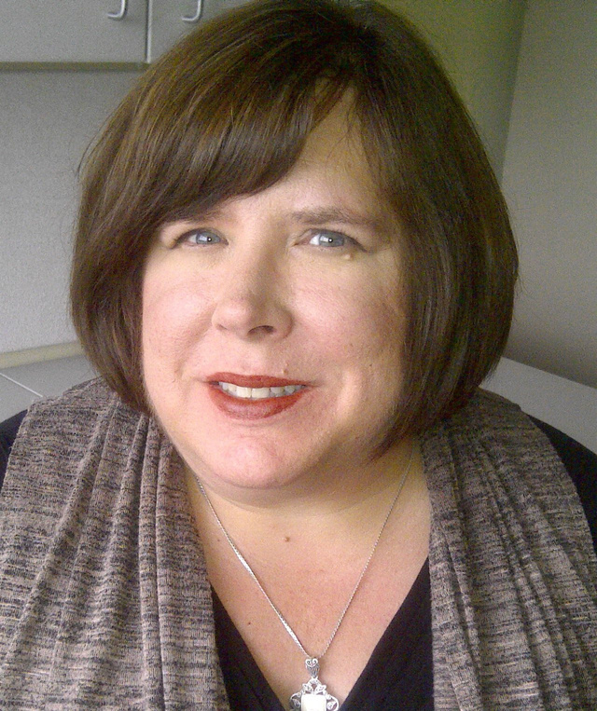
Keep Connected
AARP Washington
18000 International Blvd
SeaTac, WA 98188
(866) 227-7457
cmaccaul@aarp.org
www.aarp.org/wa
Cathy MacCaul
AARP ADVOCACY DIRECTOR

